Slide 1
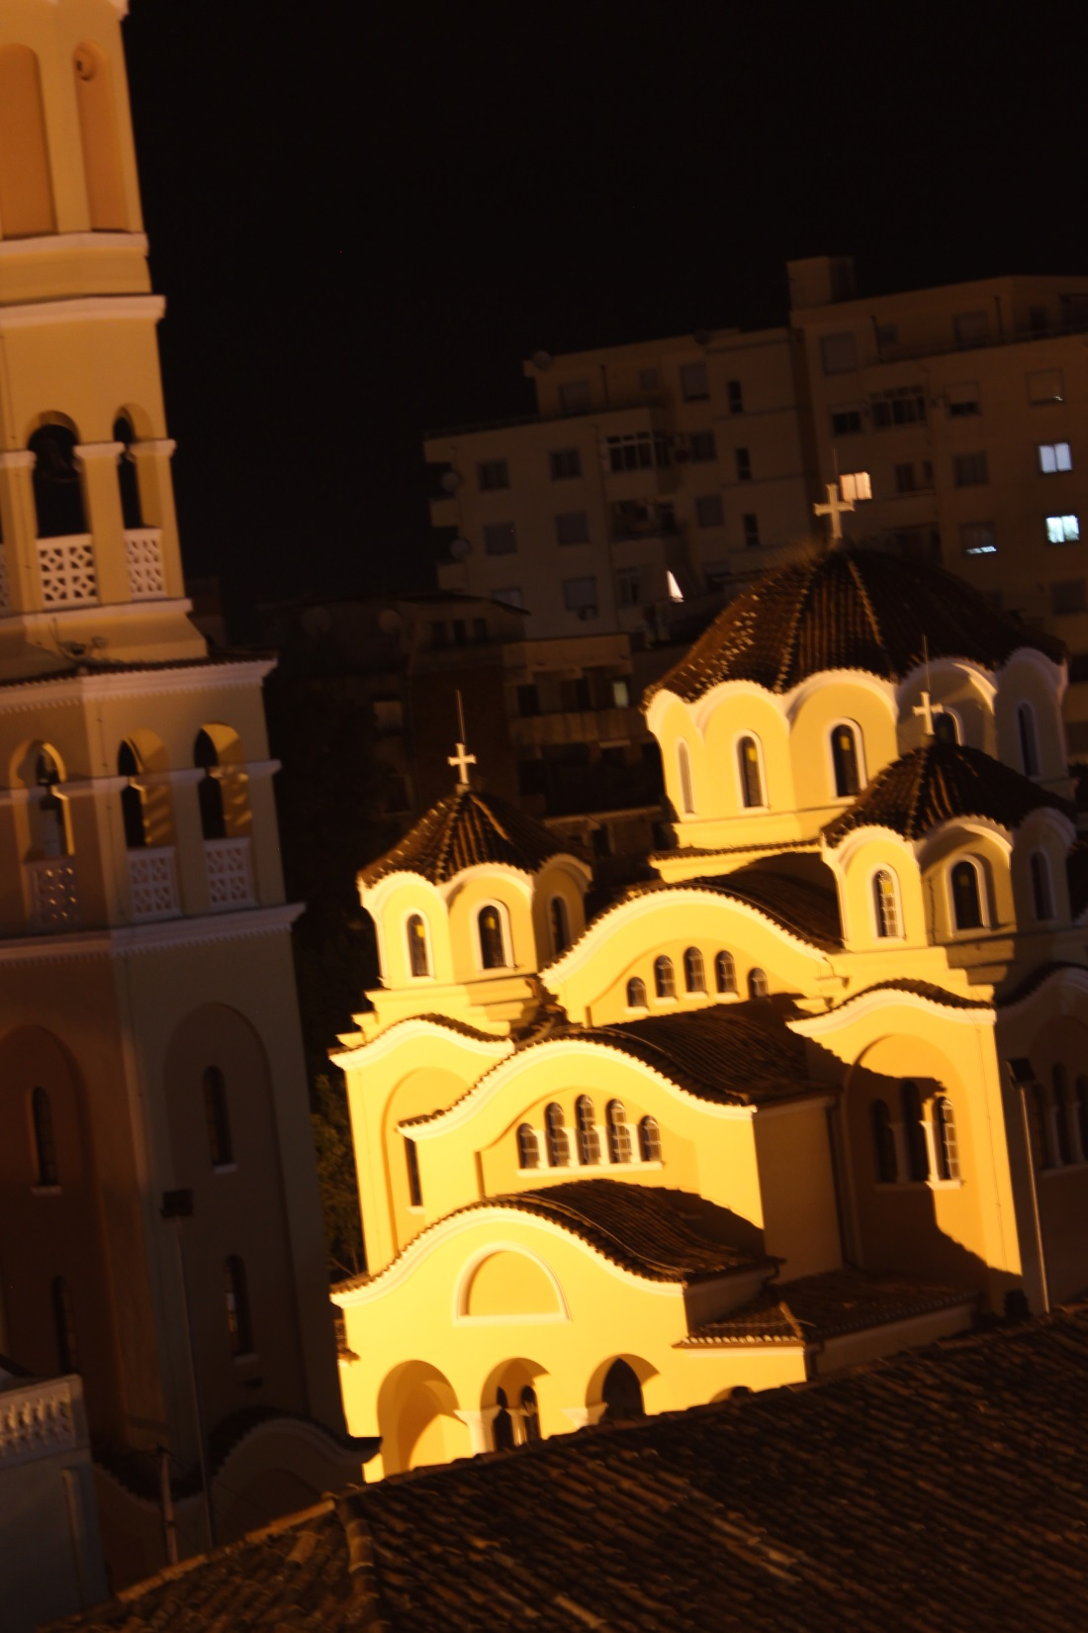
Albanian Alps Inst.
Steve’s 2014 Trip
(Photo is the Orthodox
Church in Shkodra)

Slide 2
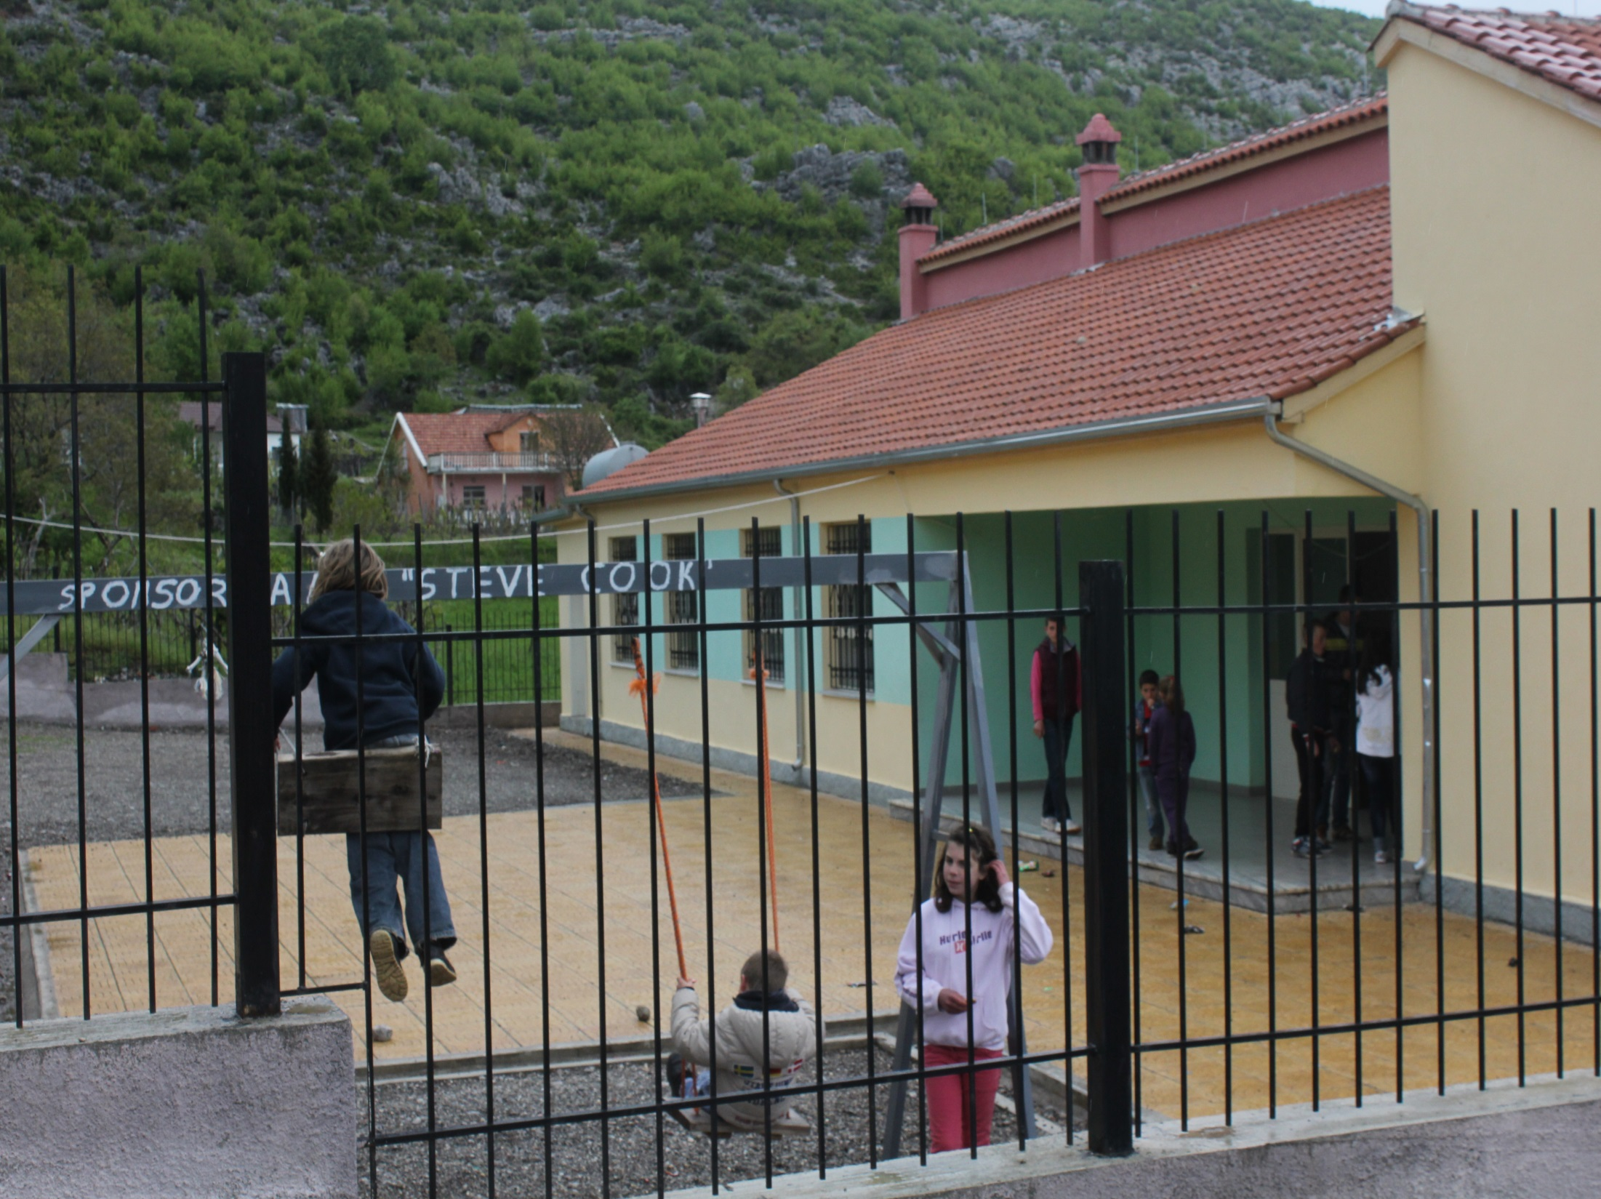
Rebuilt Vrithe
K-9 School

Slide 3
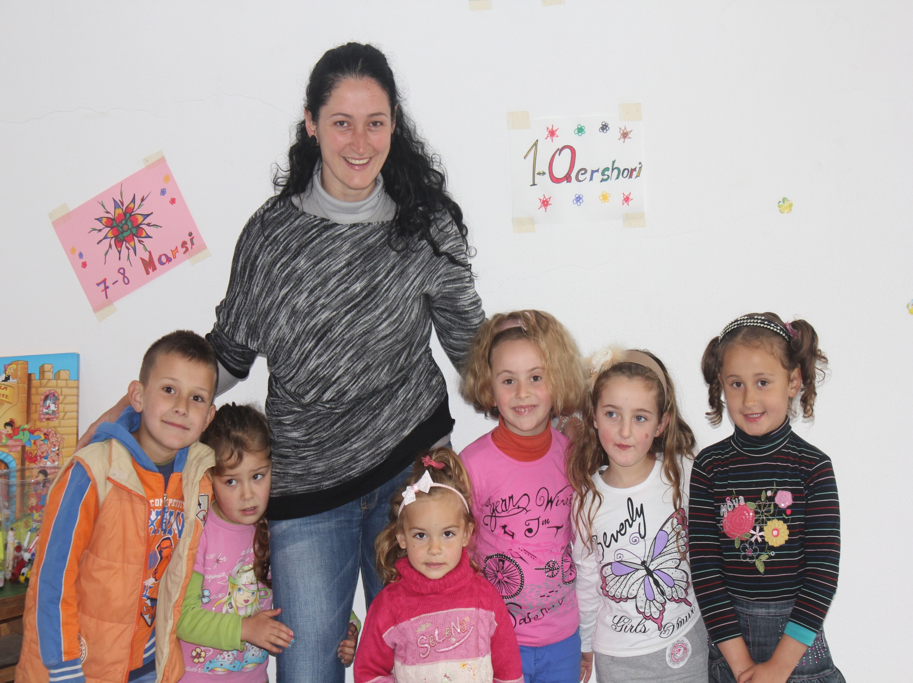
Vrithe
Kindergarten
Klodeta Kuqaj
Teacher

Slide 4
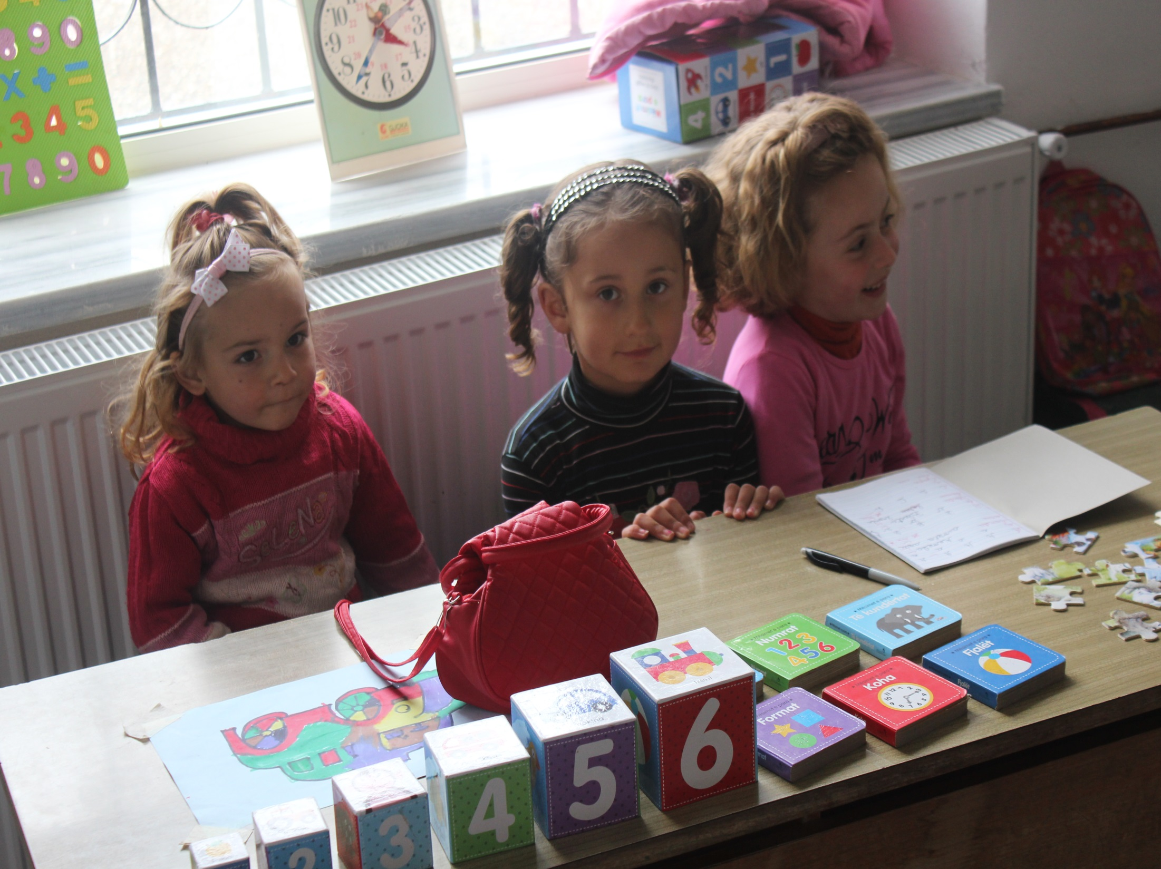

Slide 5
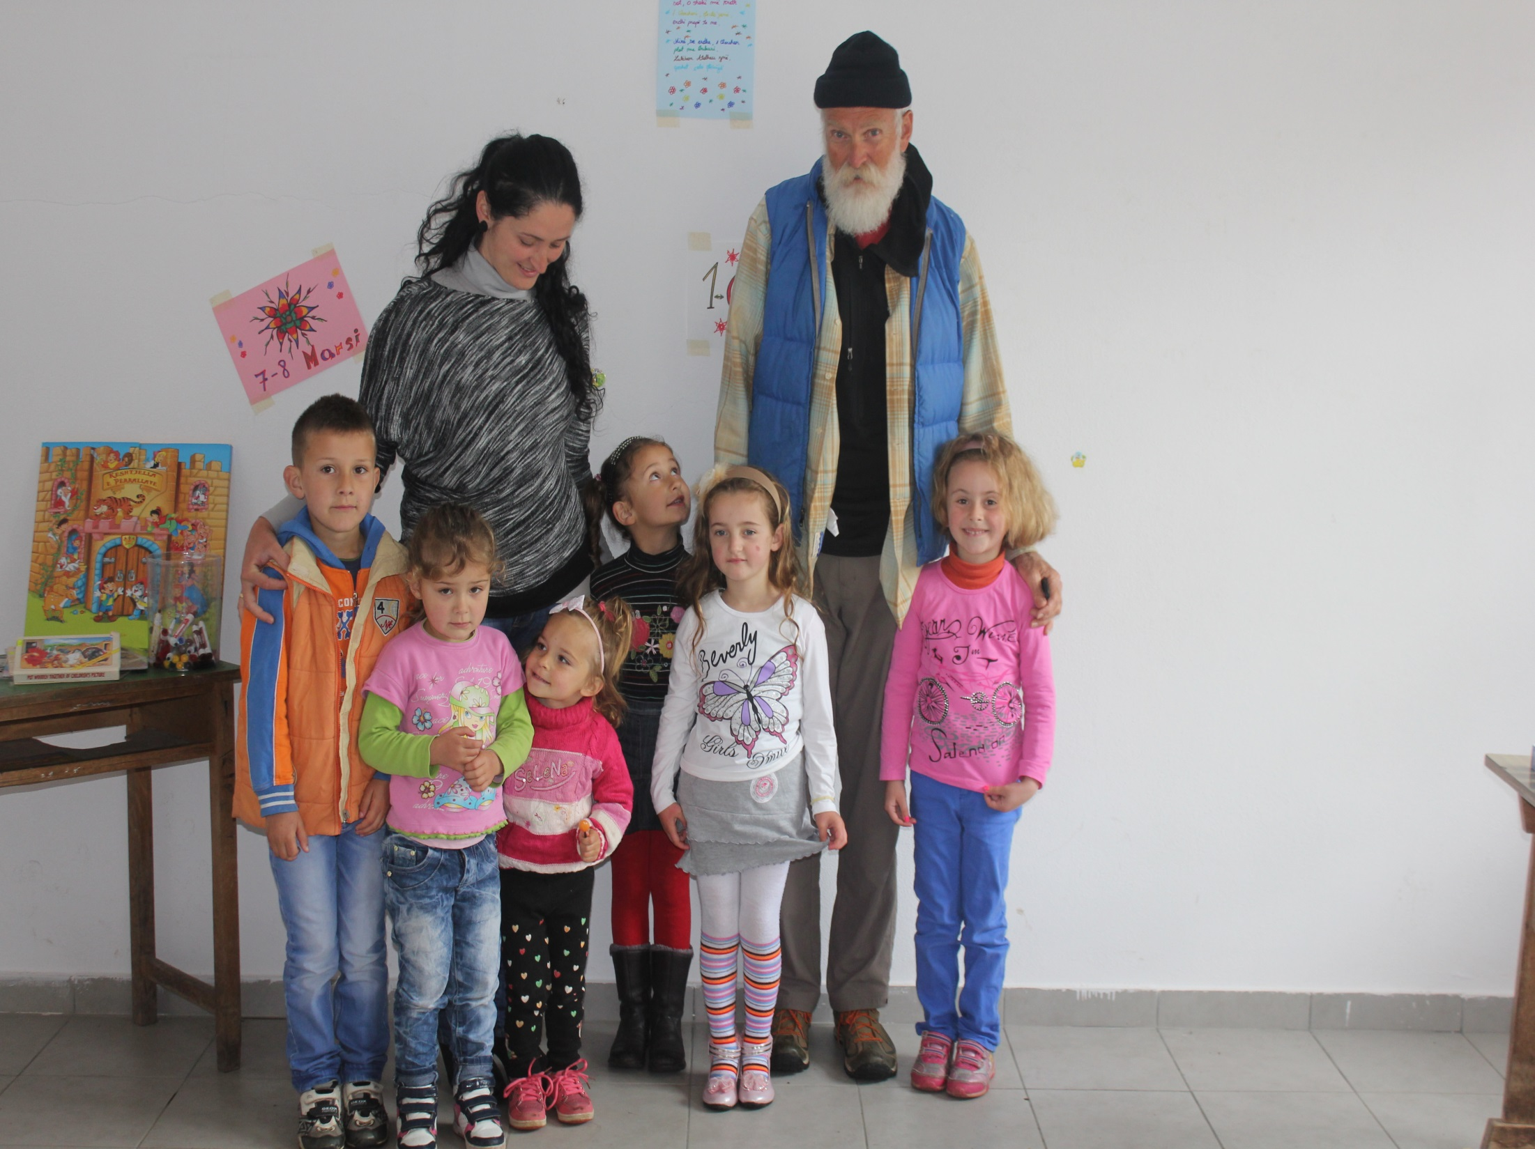

Slide 6
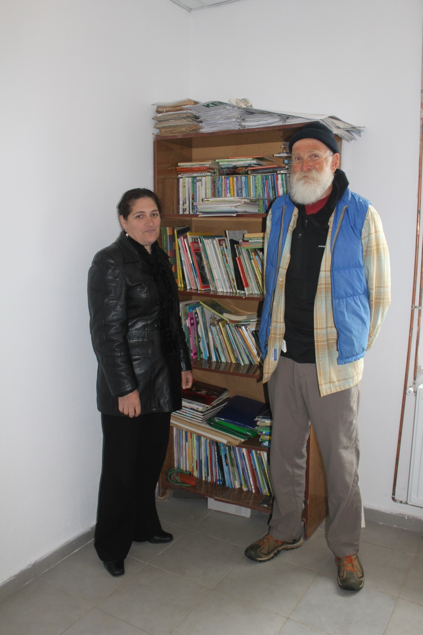
Vrithe Library
Librarian Nikoleta Purashaj

Slide 7
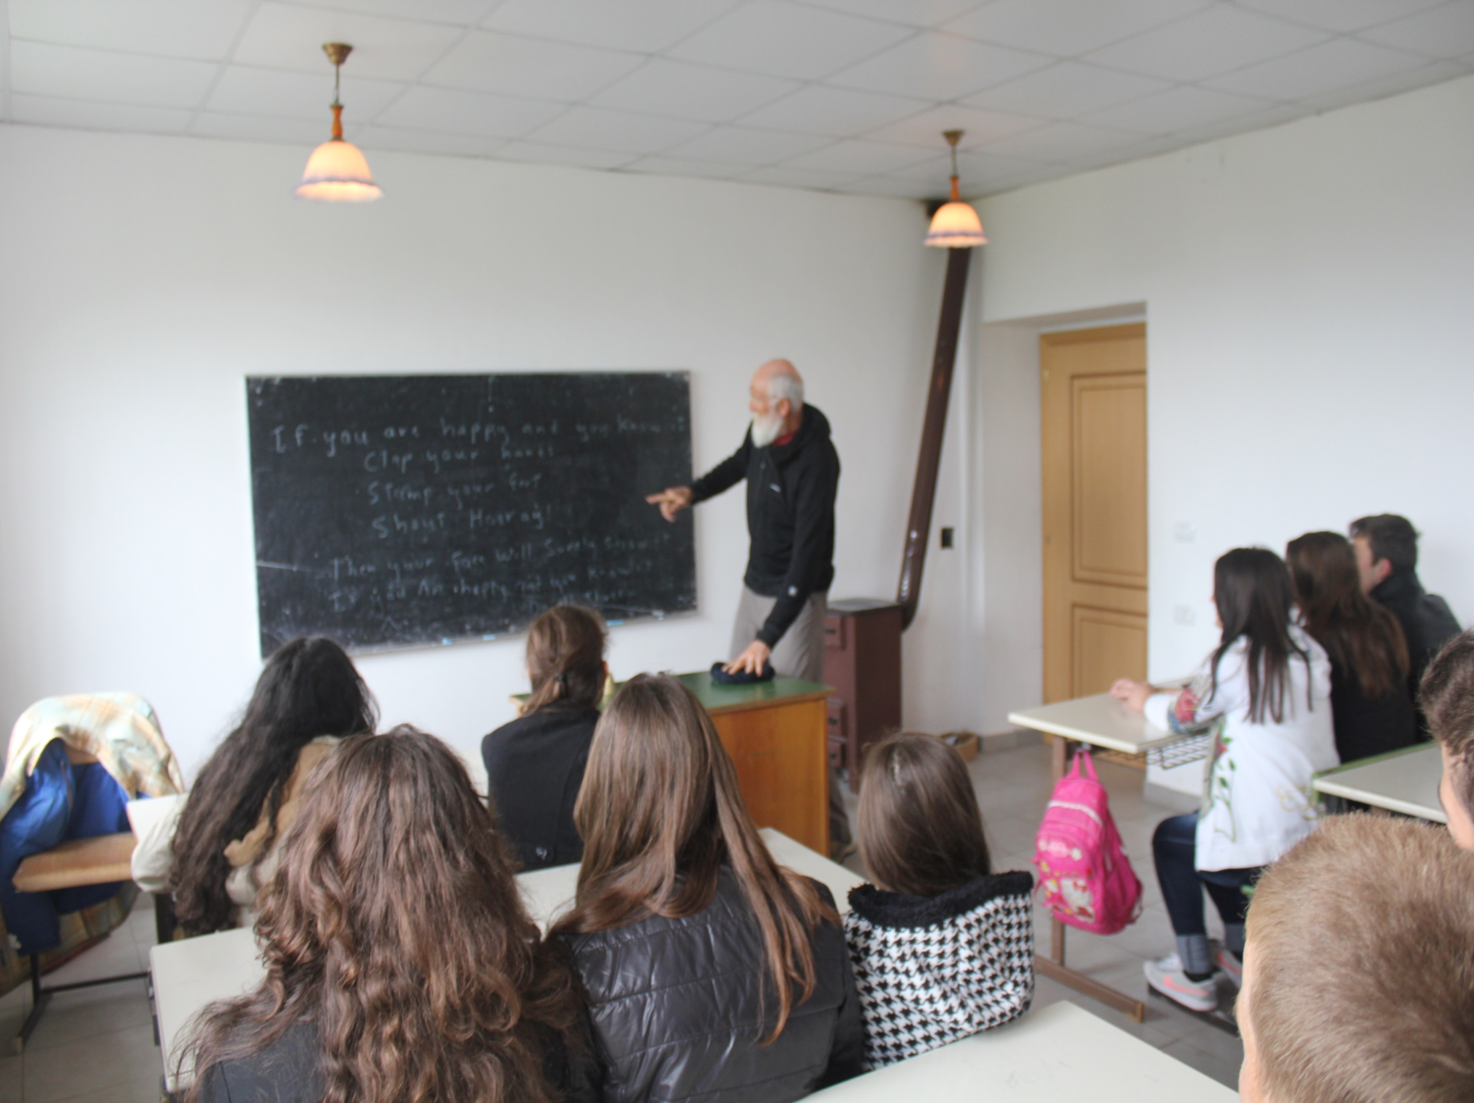

Slide 8
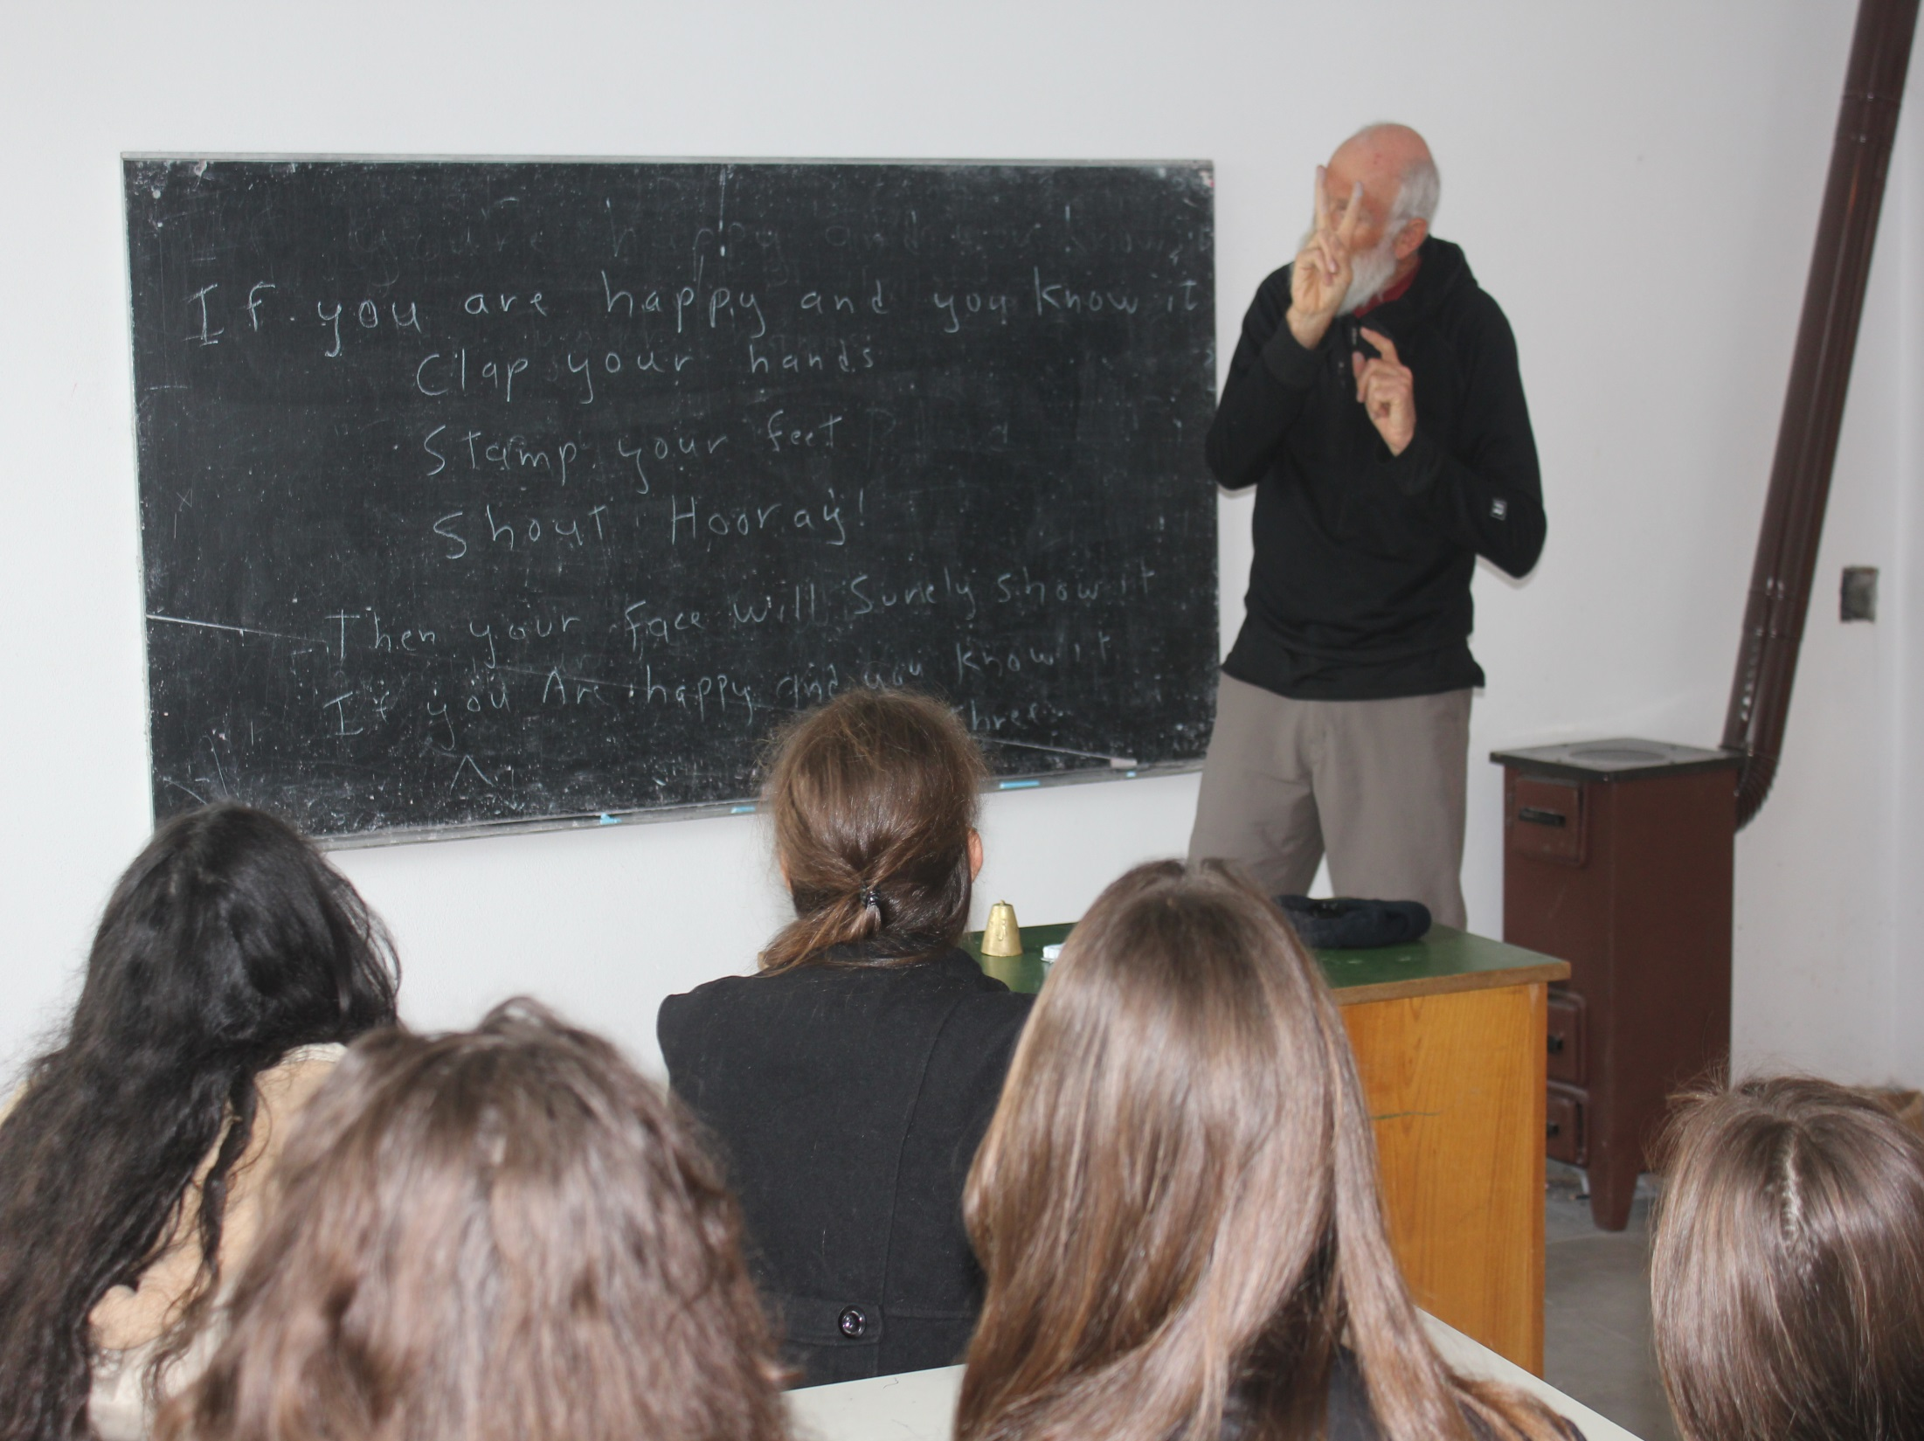

Slide 9
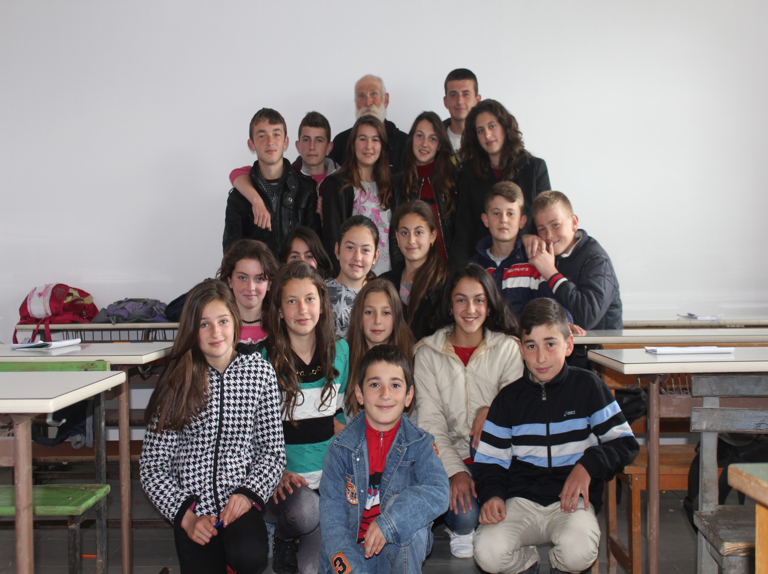

Slide 10
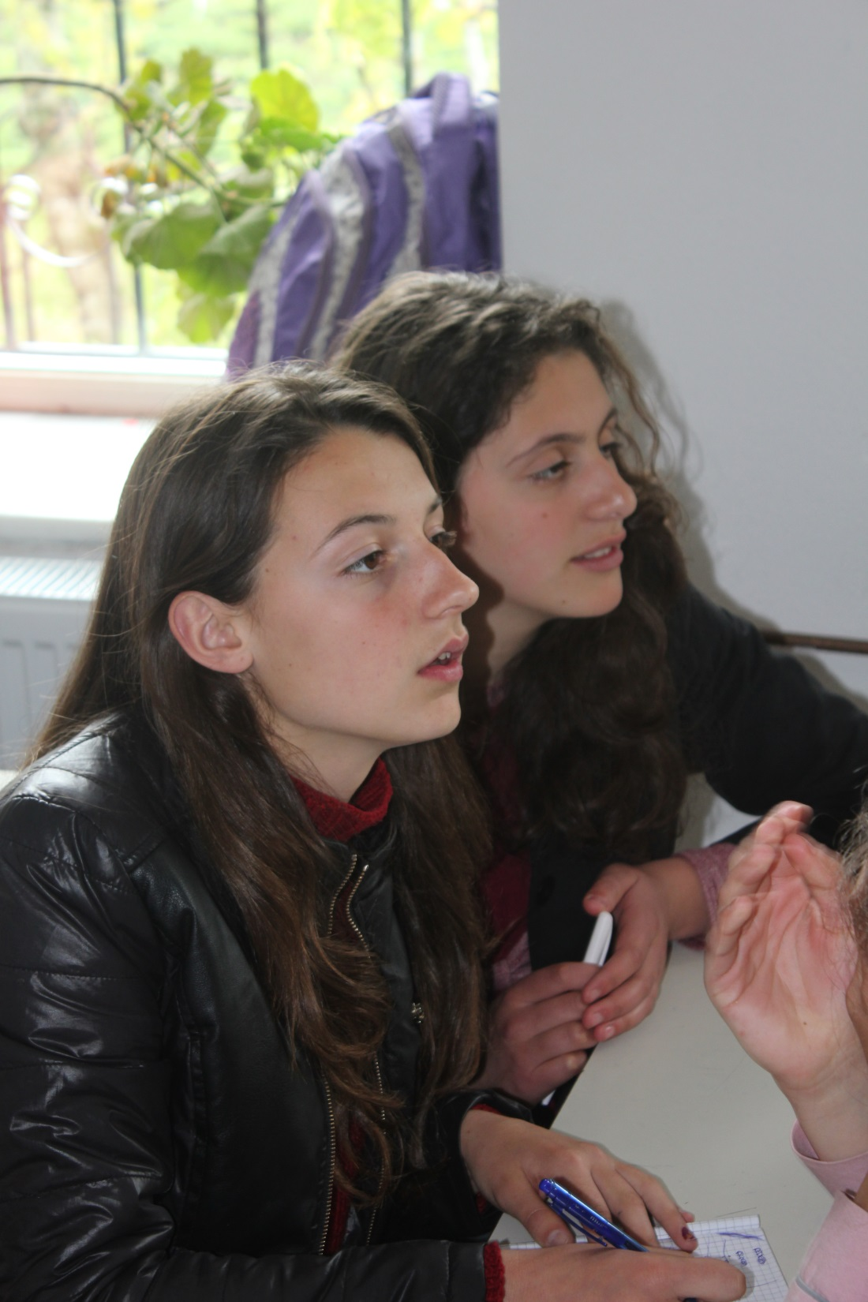

Slide 11
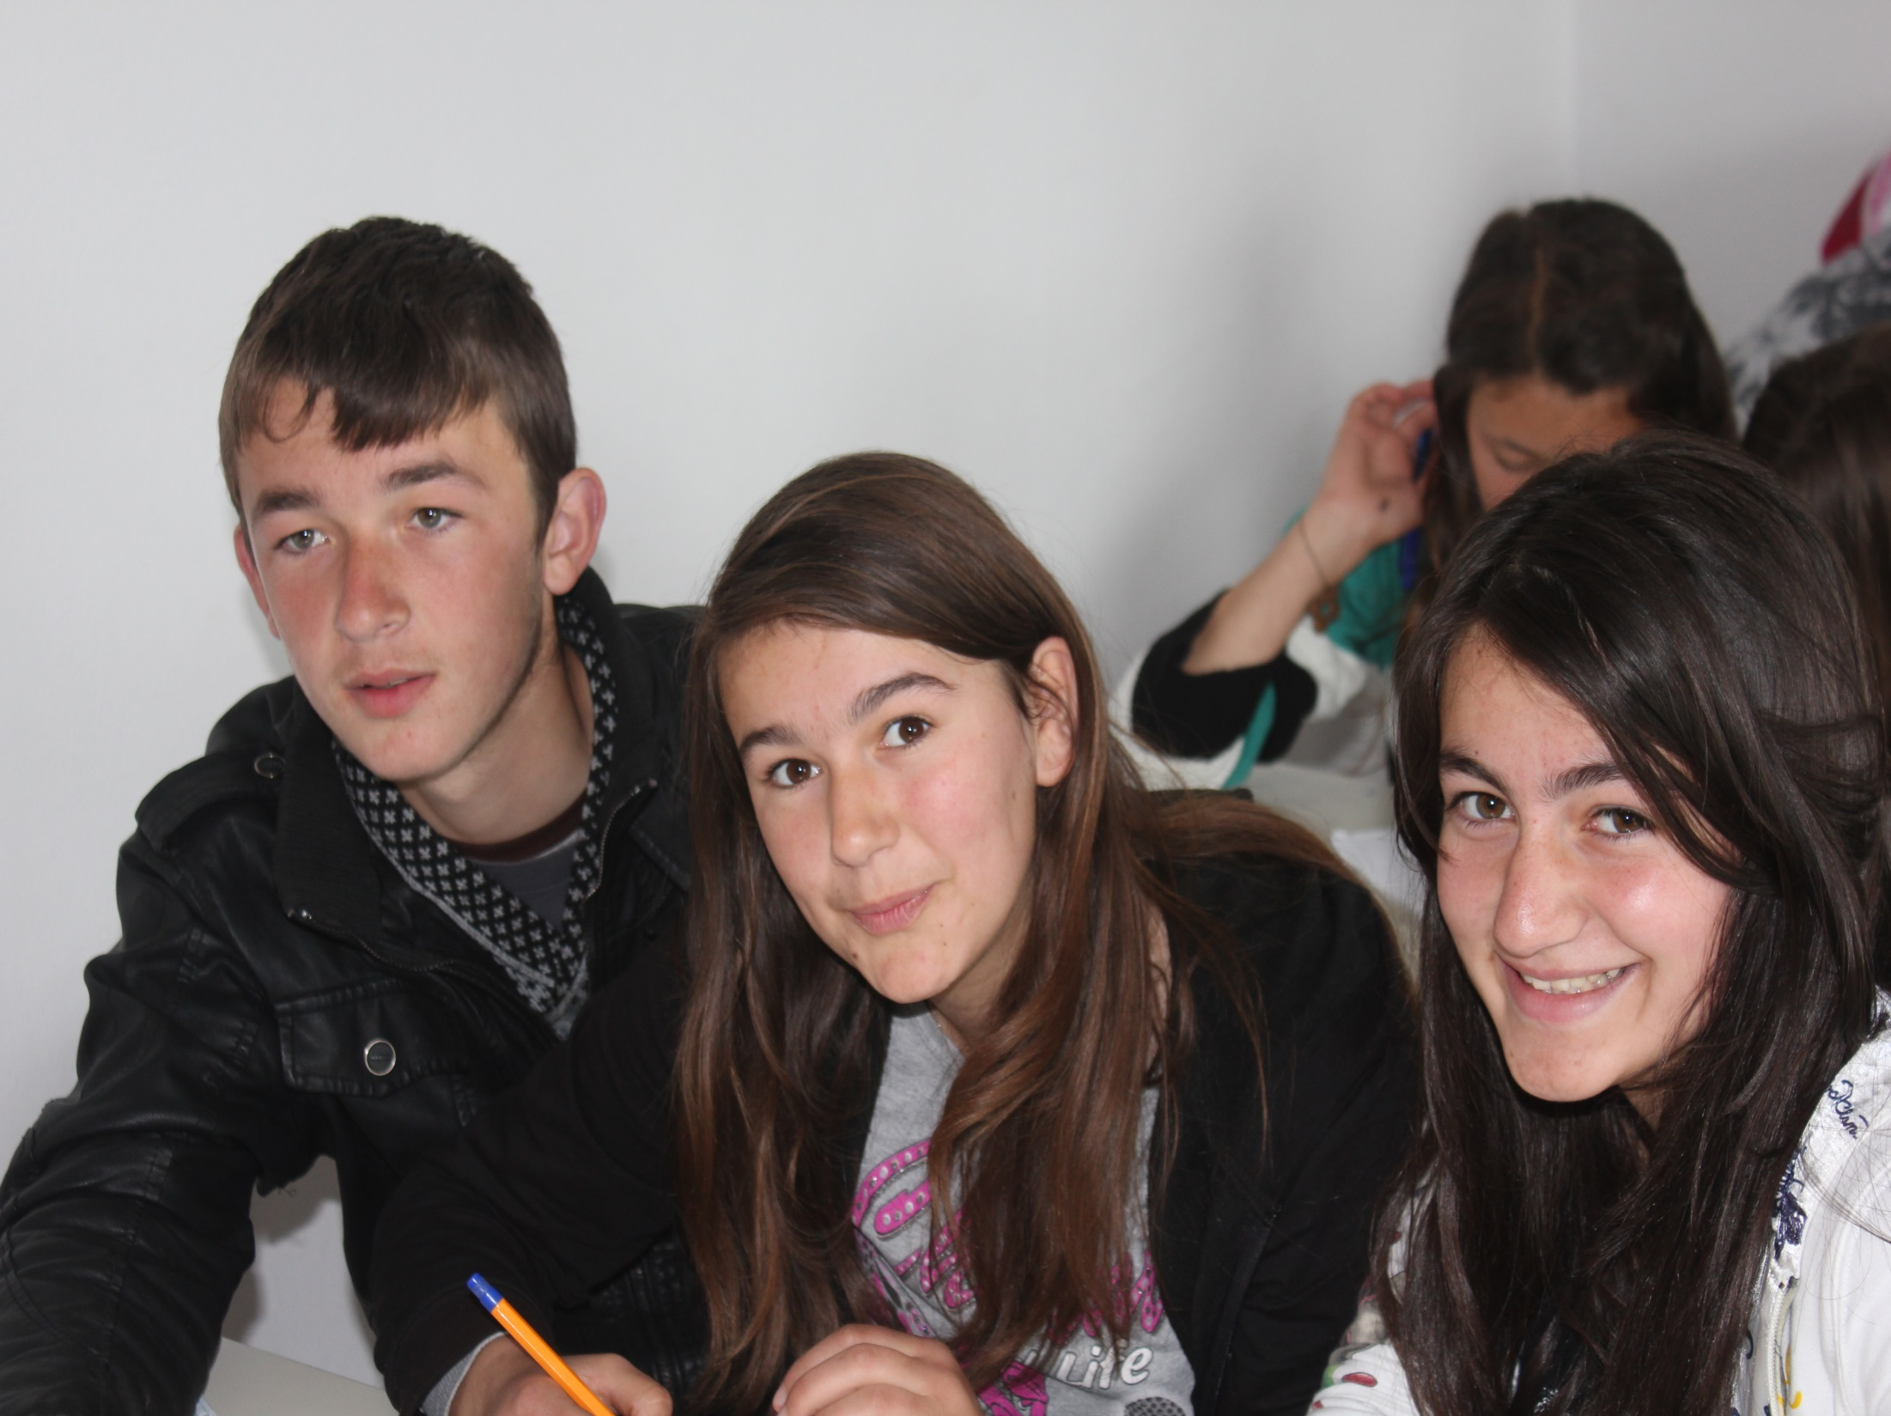

Slide 12
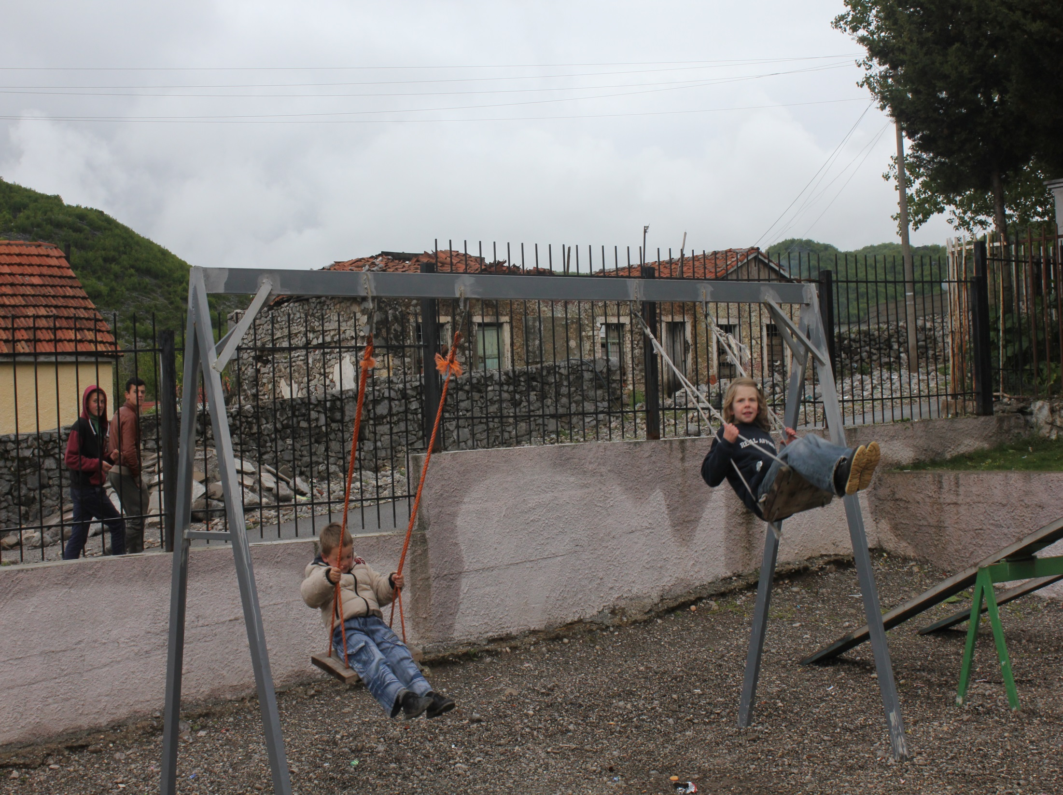

Slide 13
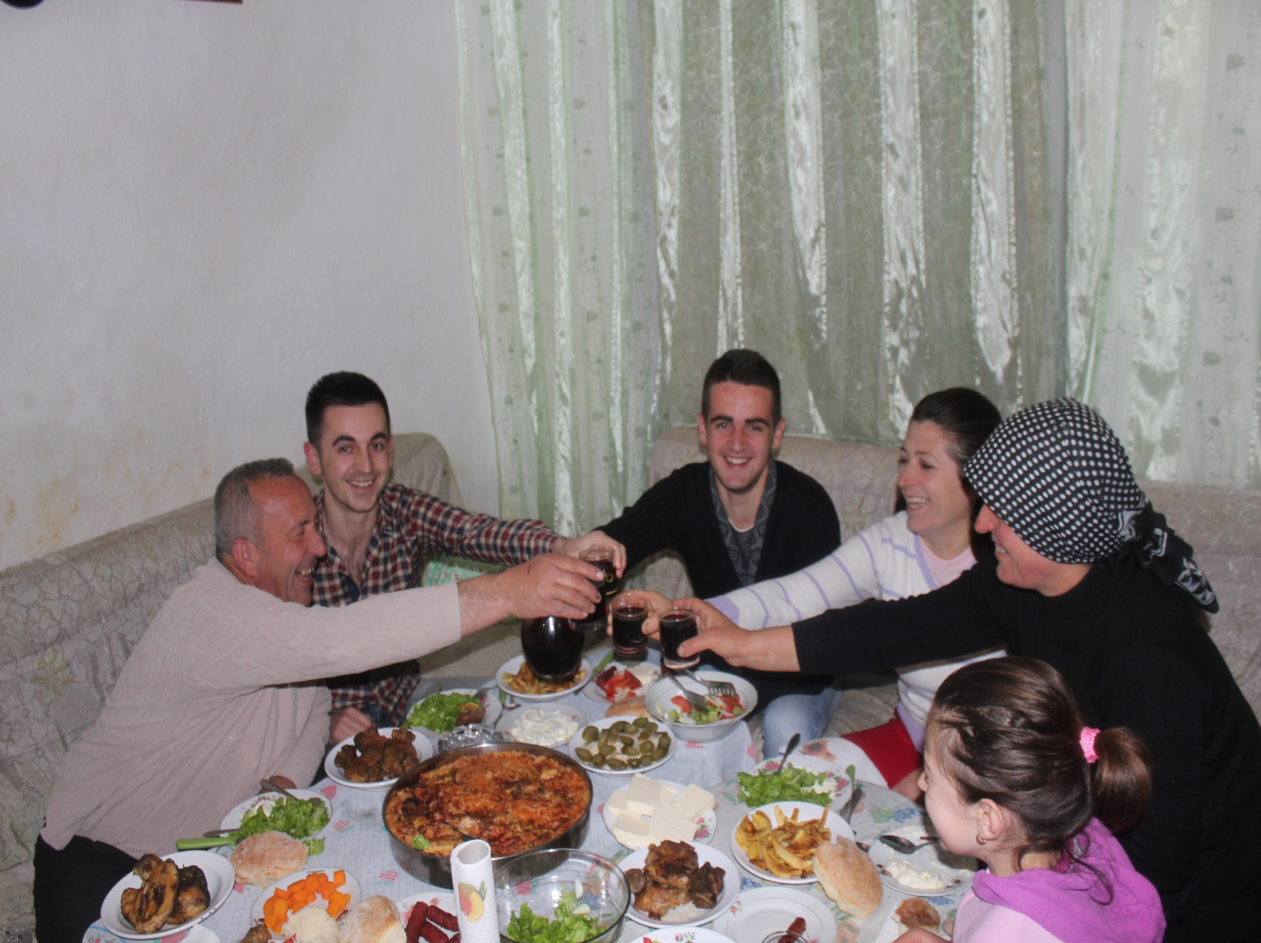
Kristina’s family

Slide 14
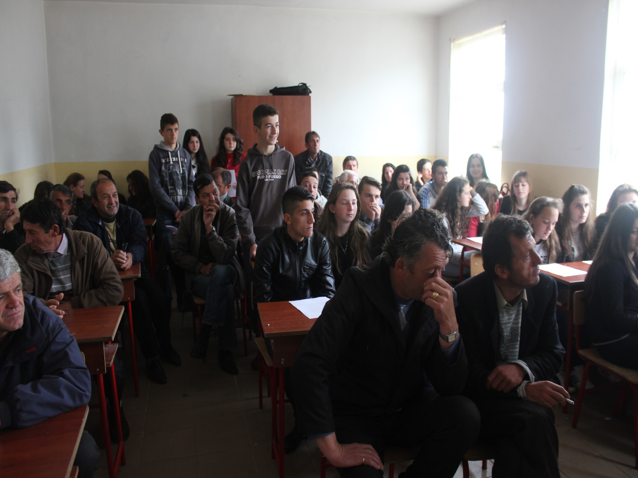
Meeting in Dedaj for Scholarship Applicants

Slide 15
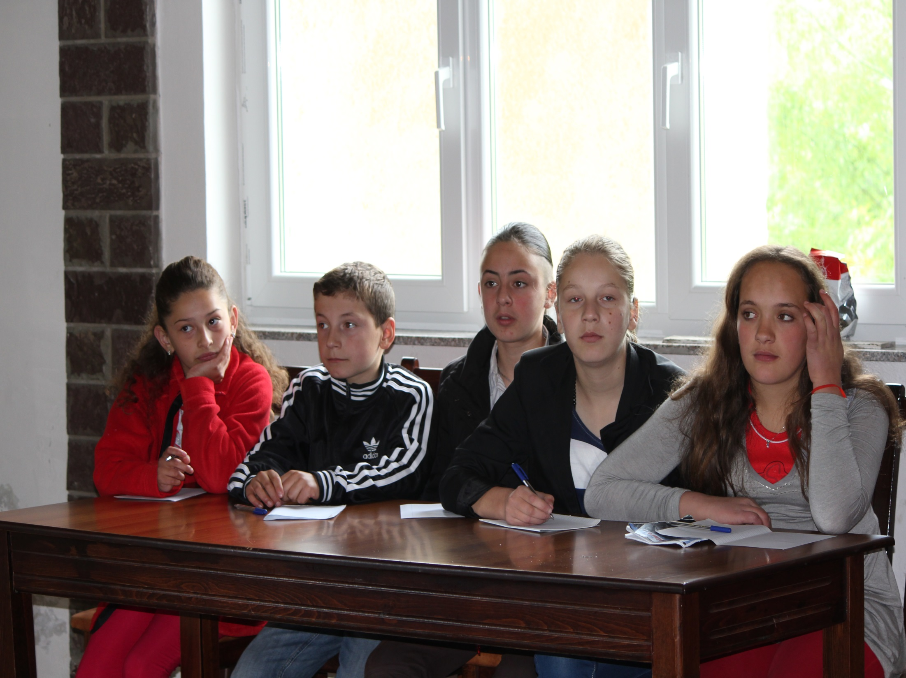
Boga Team at the English Language Competition

Slide 16
Xhaj Team at English
Language Competition

Slide 17
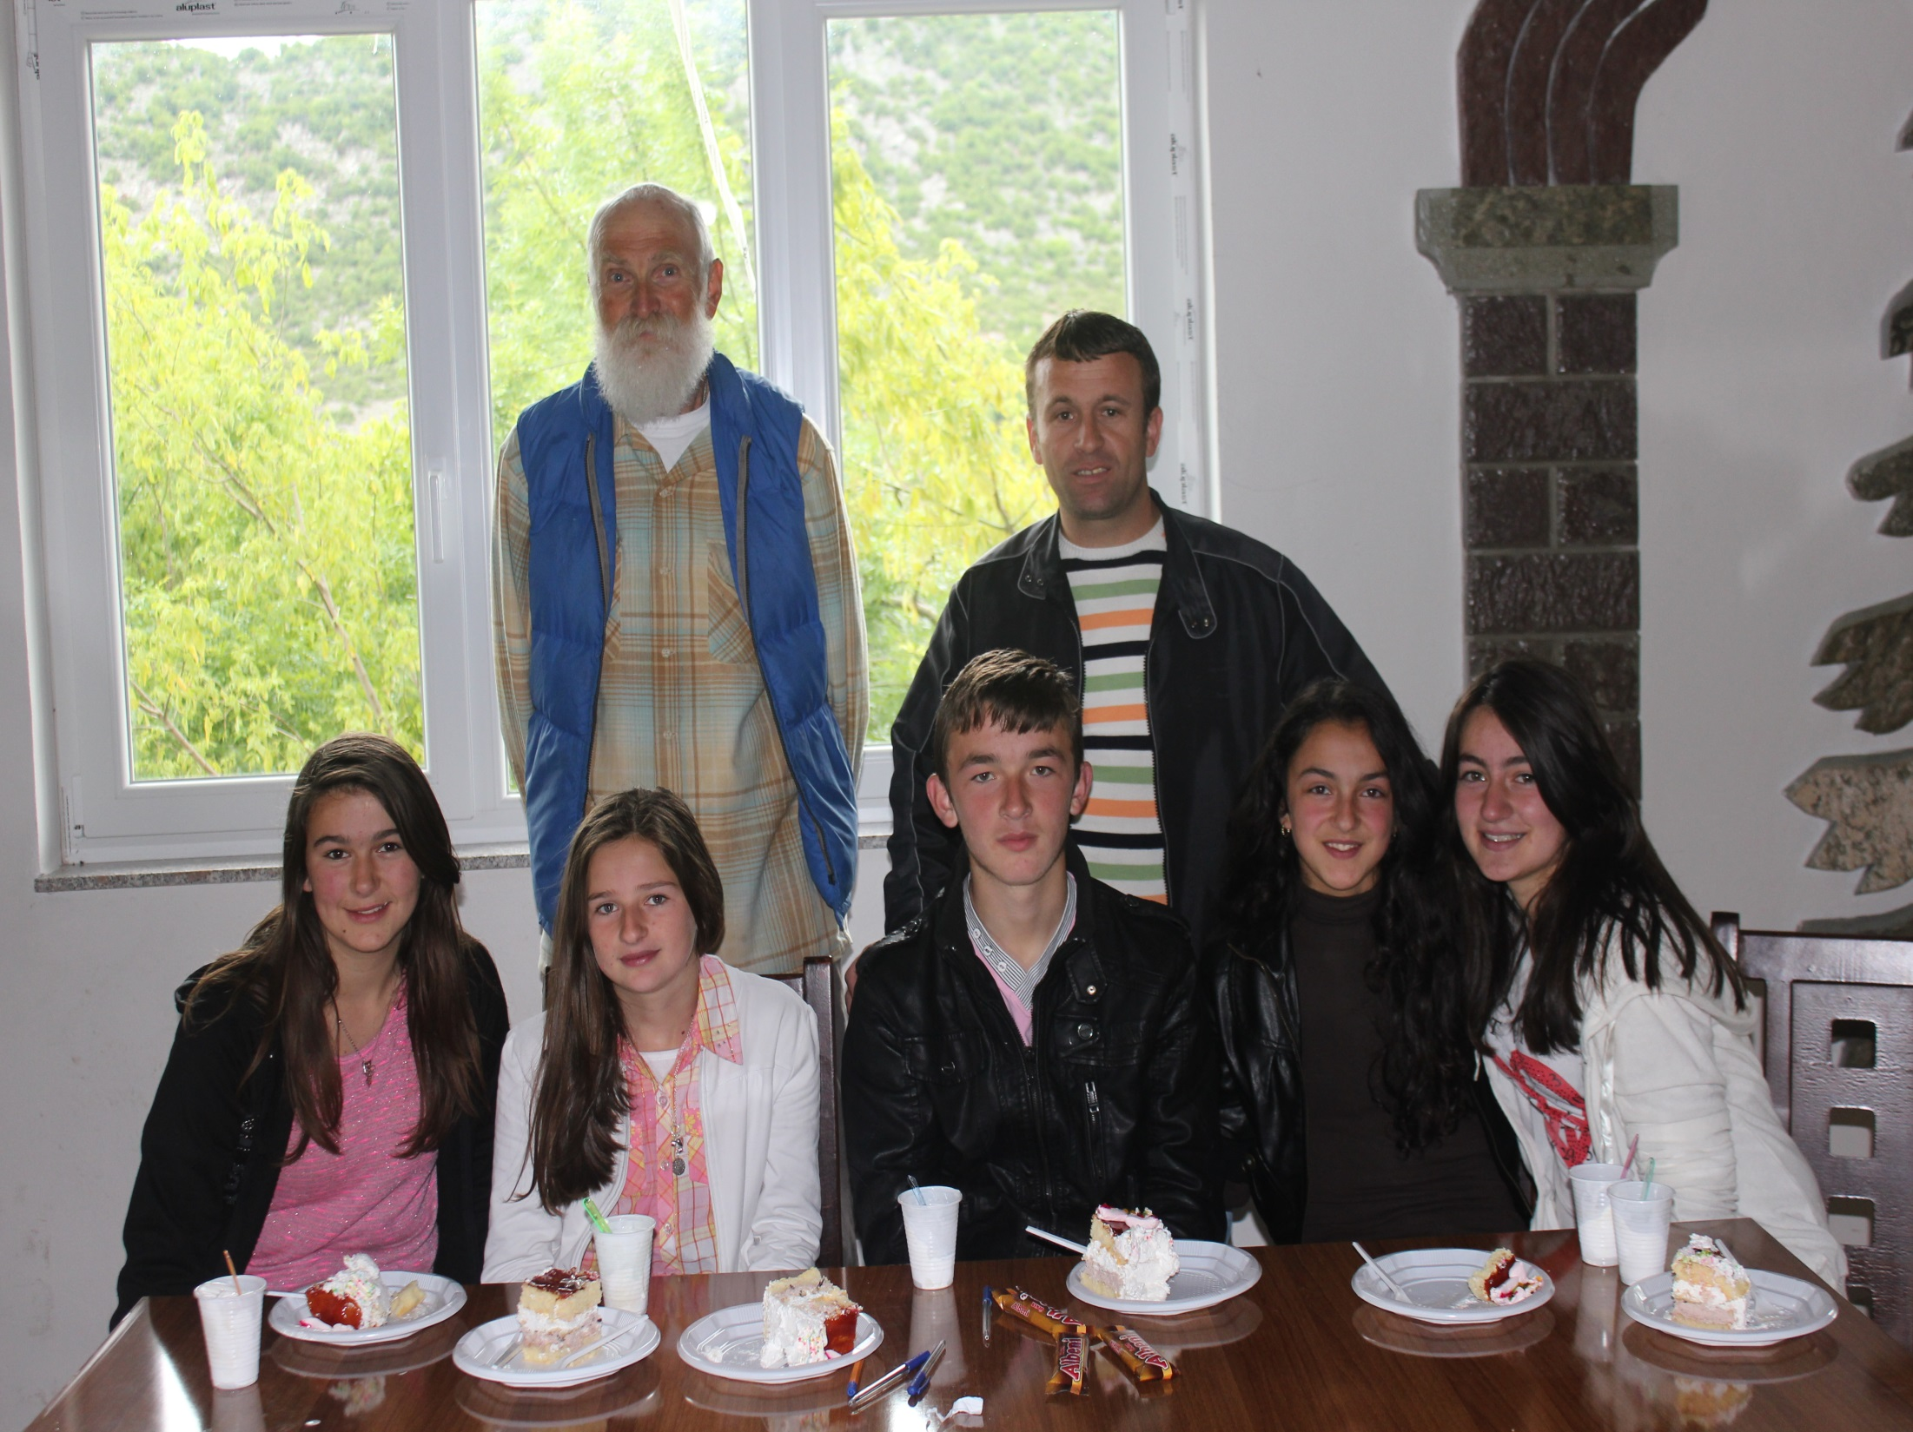
AAI English teacher and Vrithi Team at Competition

Slide 18
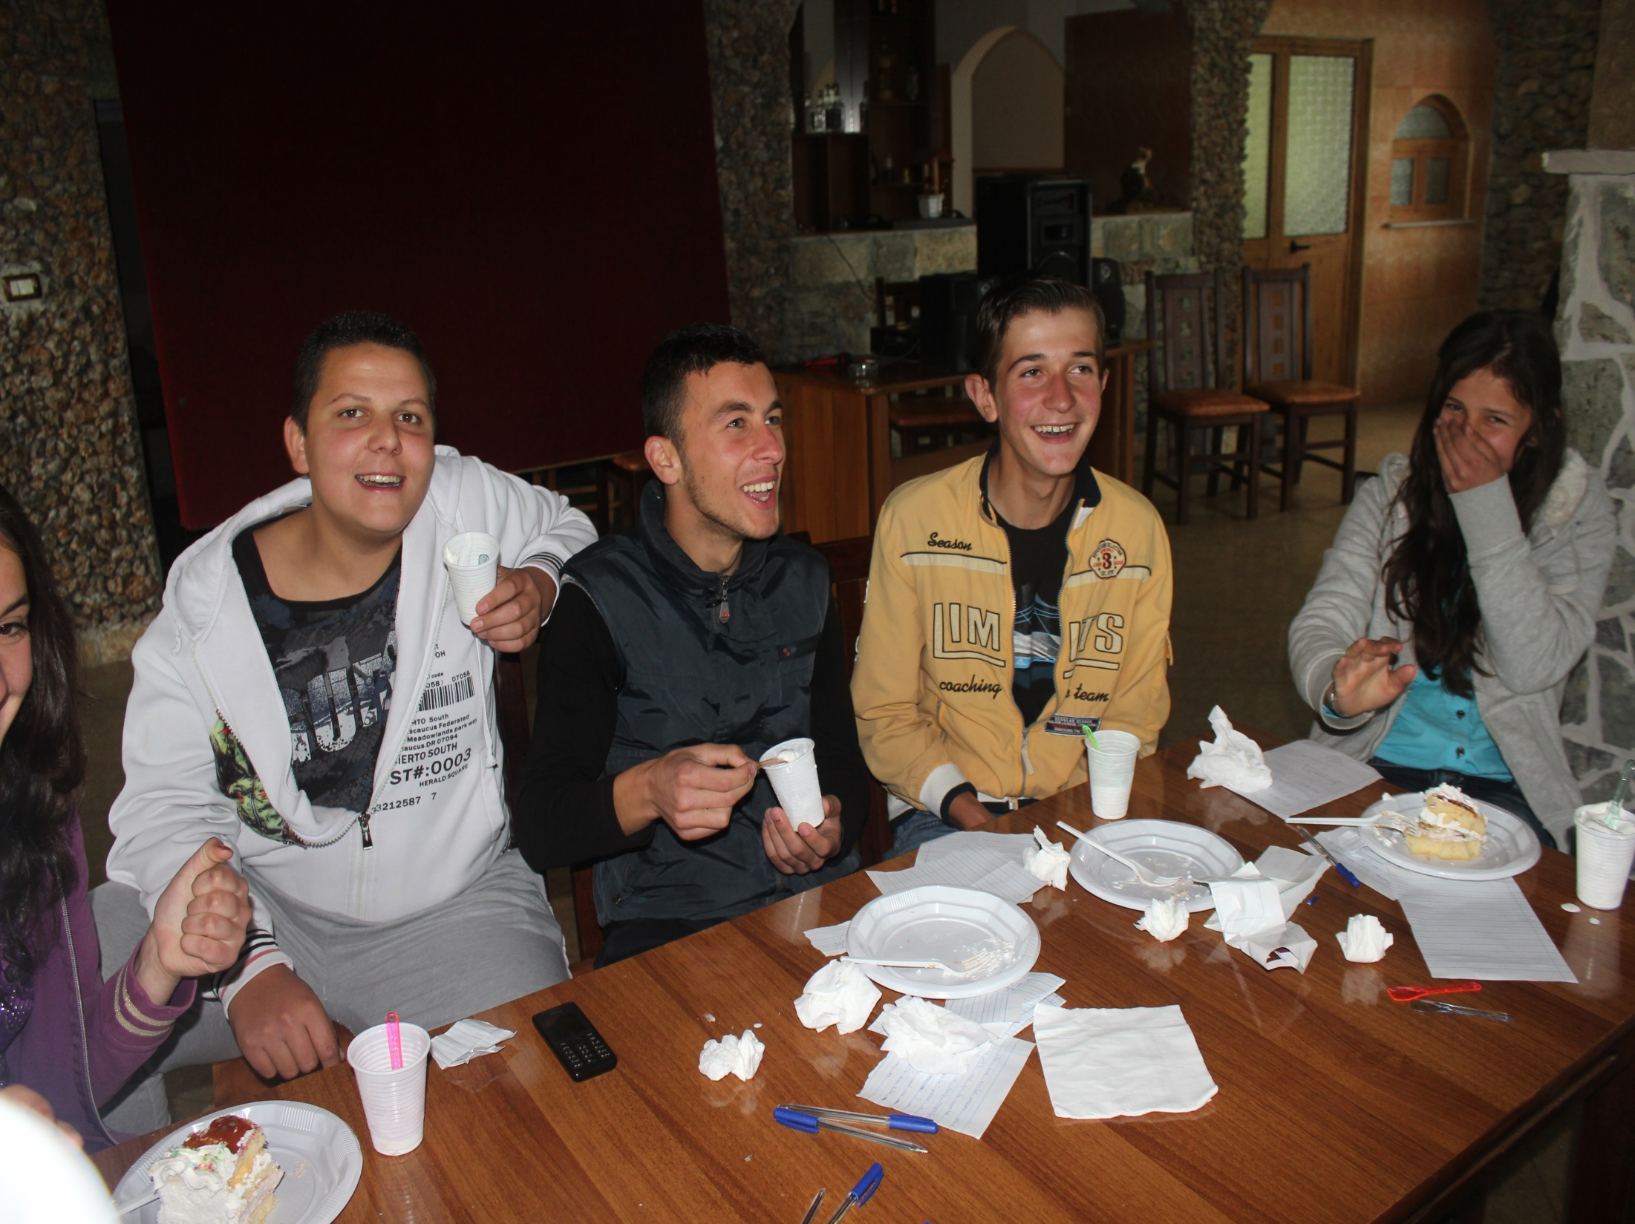
Cake and Ice Cream Around
Dedaj Team

Slide 19
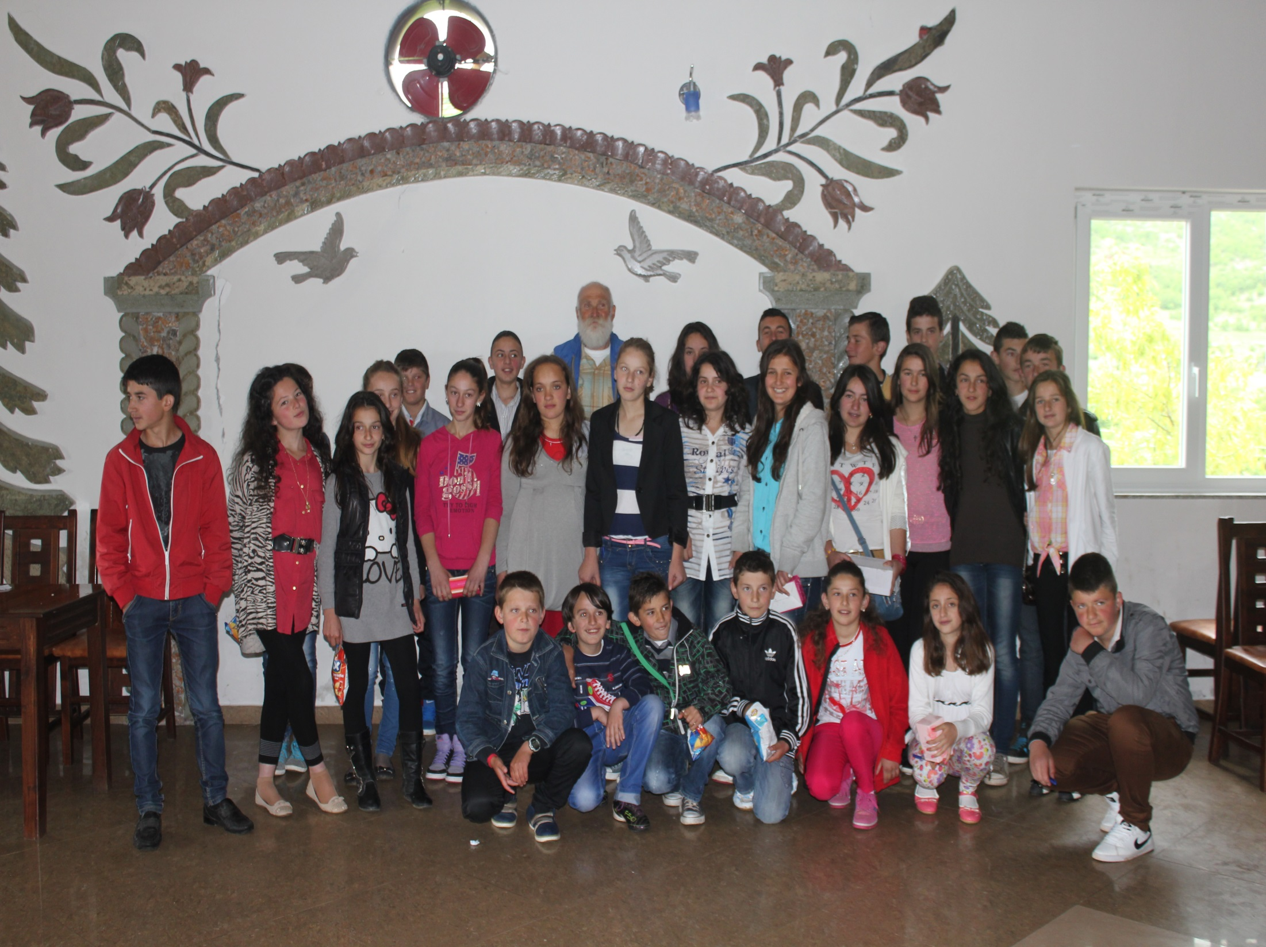

Slide 20
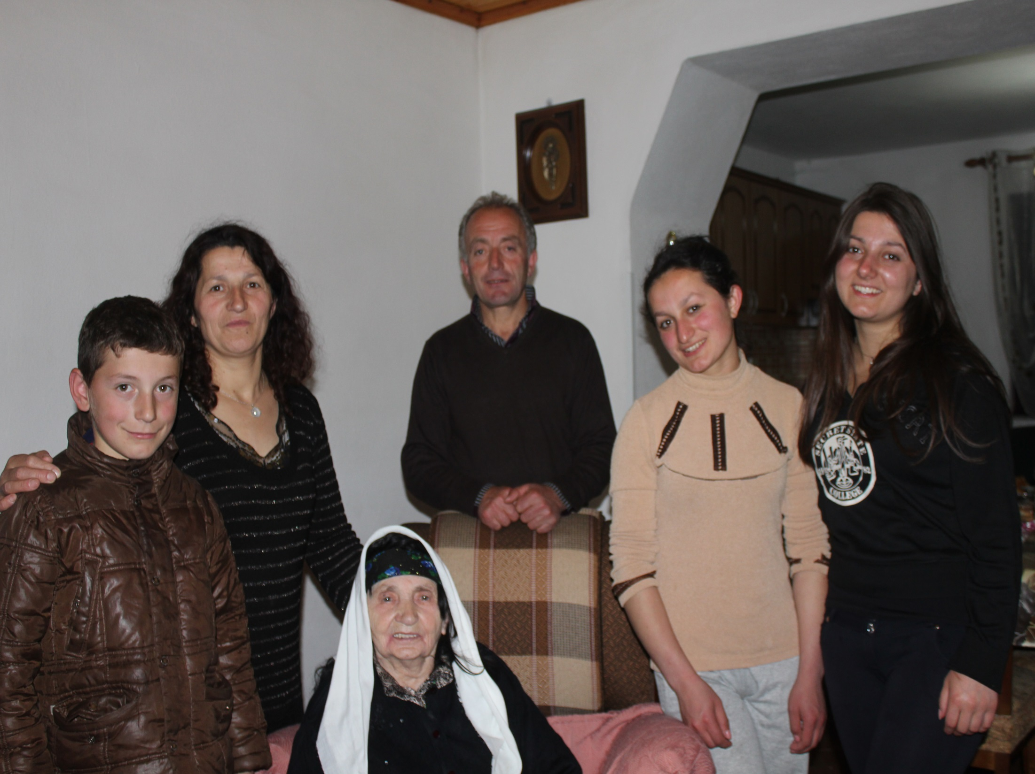
Fran and Taki Rakaj and Family
My hosts since 1992.
Grandma Dielle is almost 90.

Slide 21
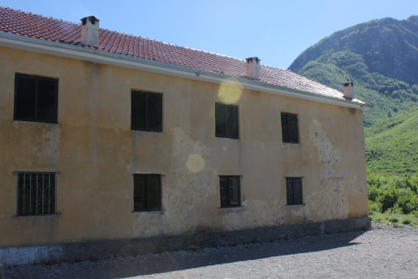
Xhaj School

Slide 22
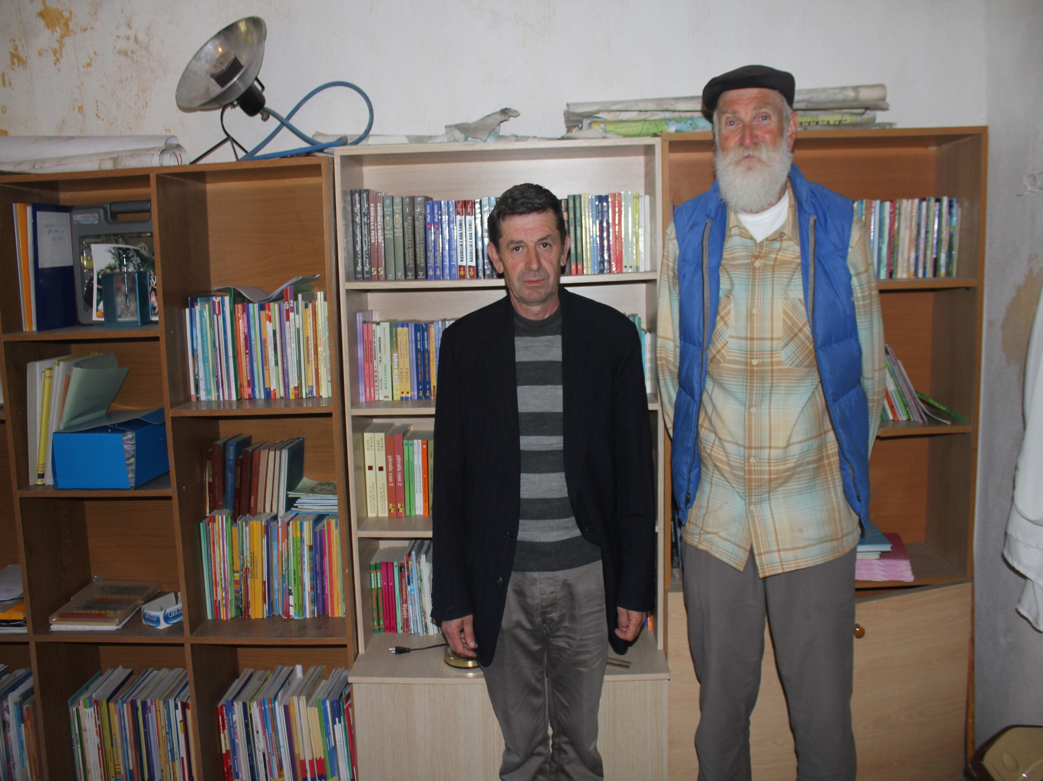
Nue Durgaj, Xhaj School Director and Library

Slide 23
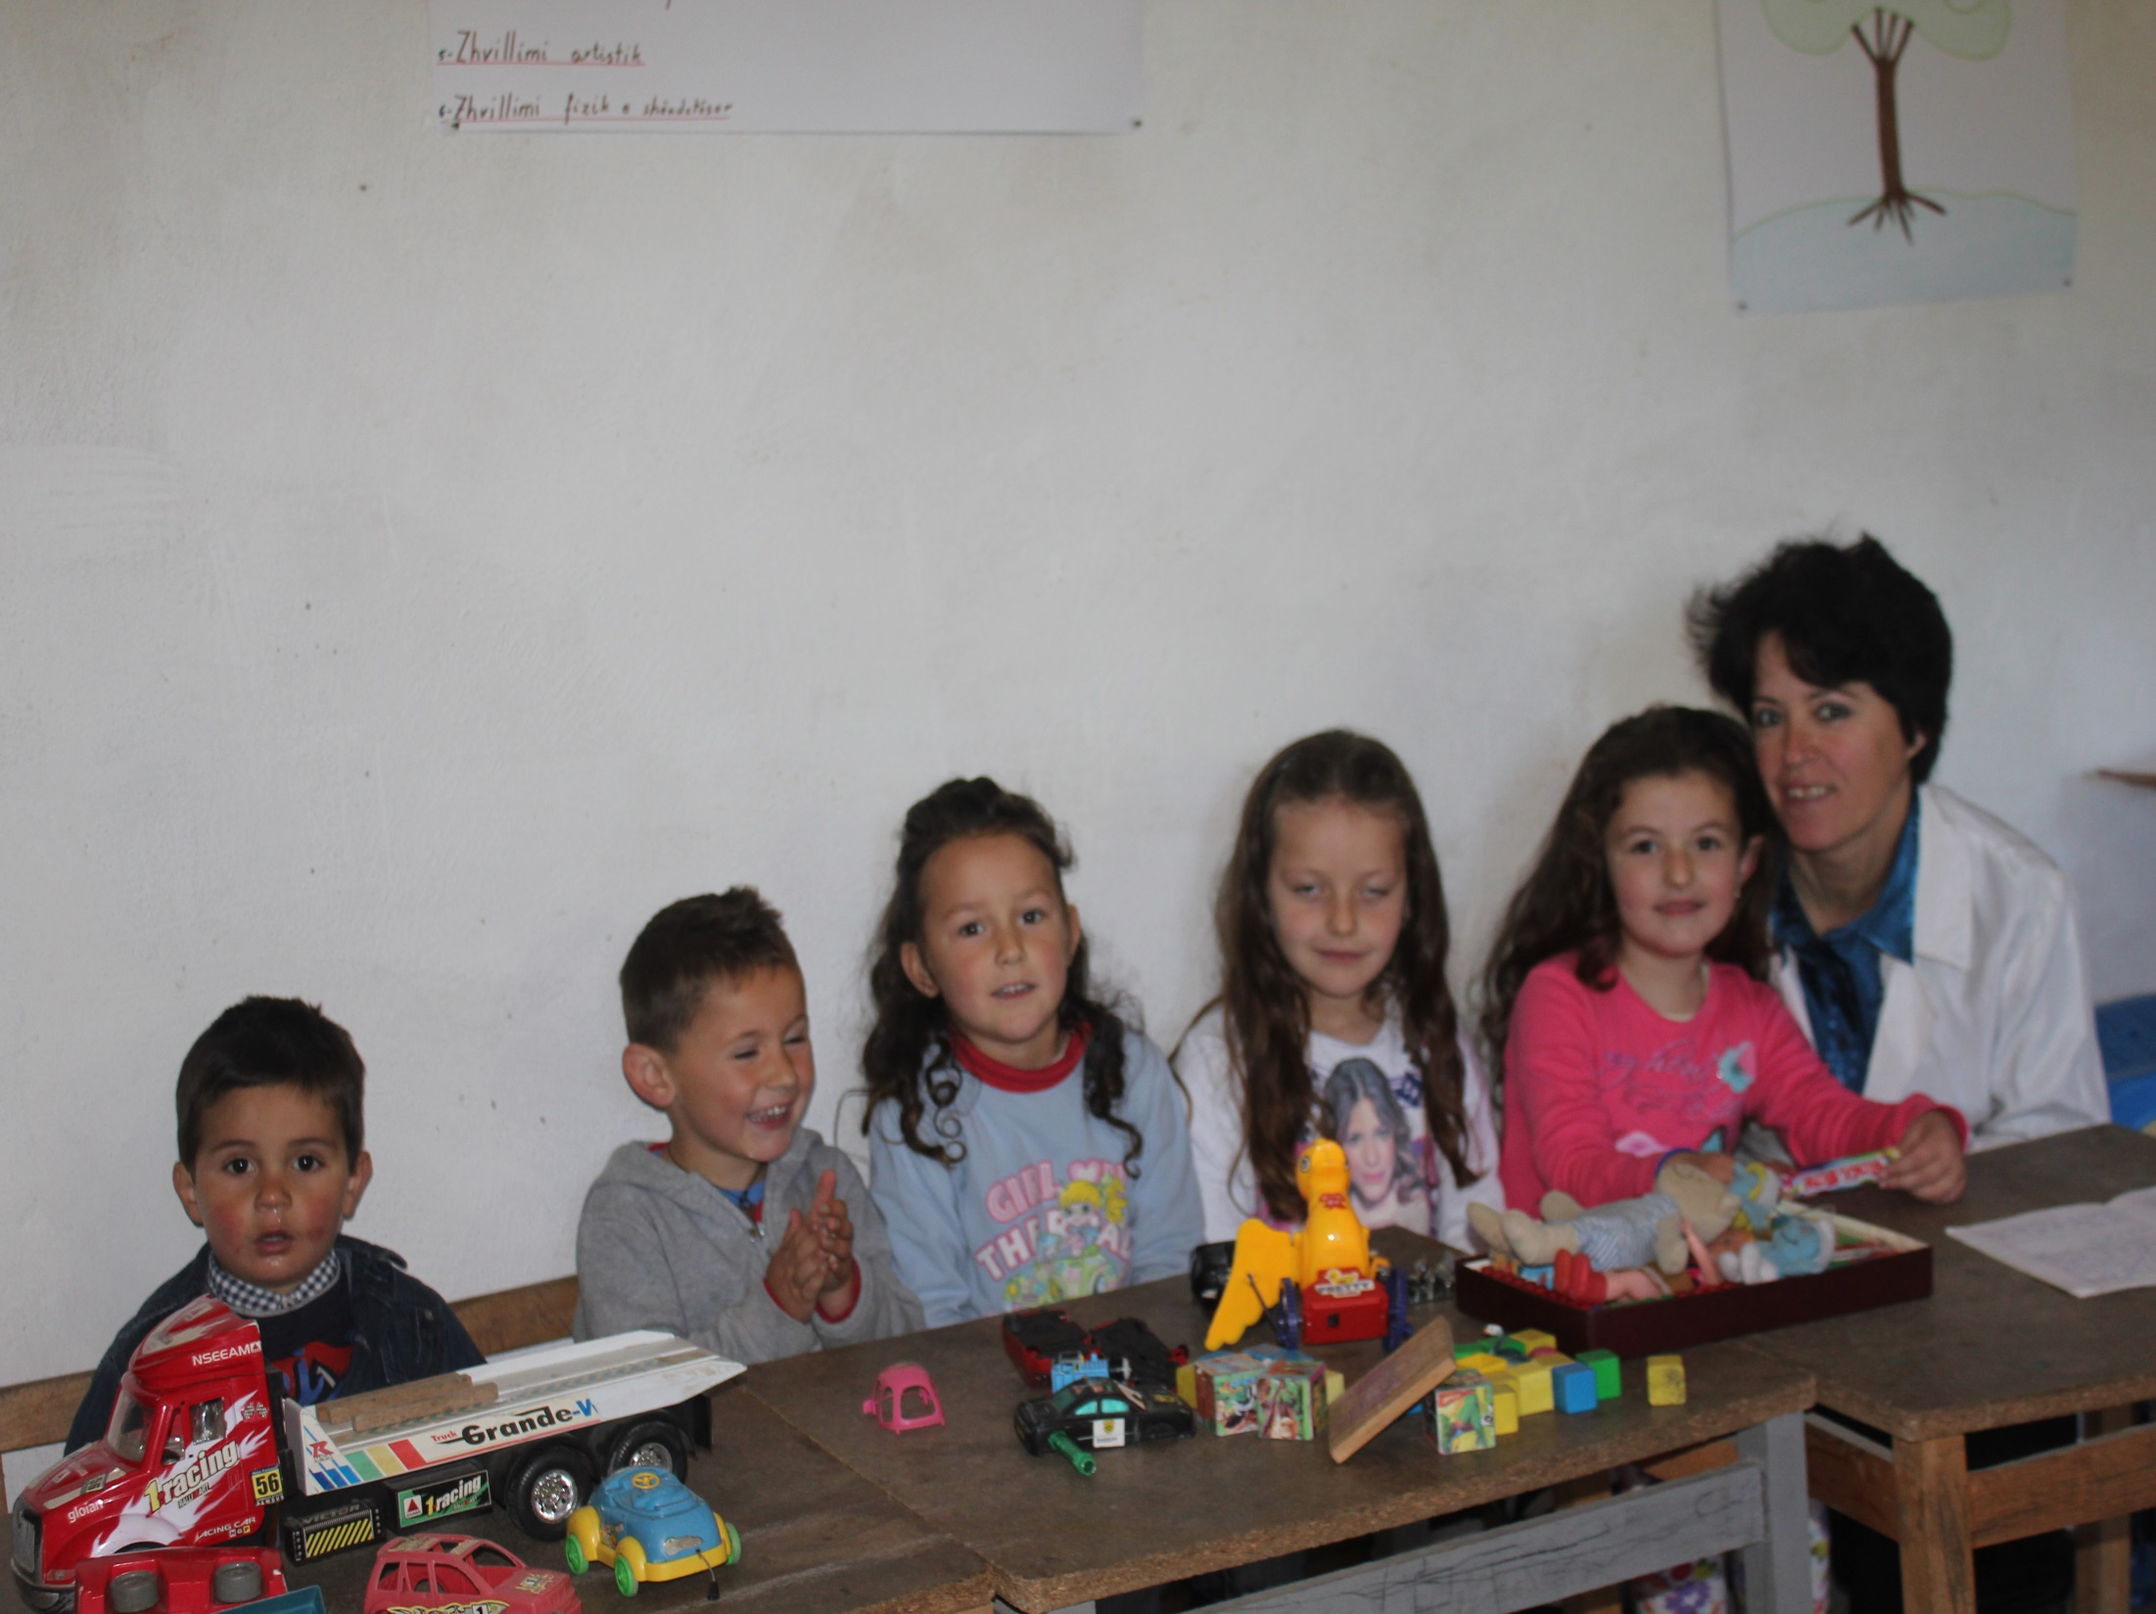
Xhaj Kindergarten

Slide 24
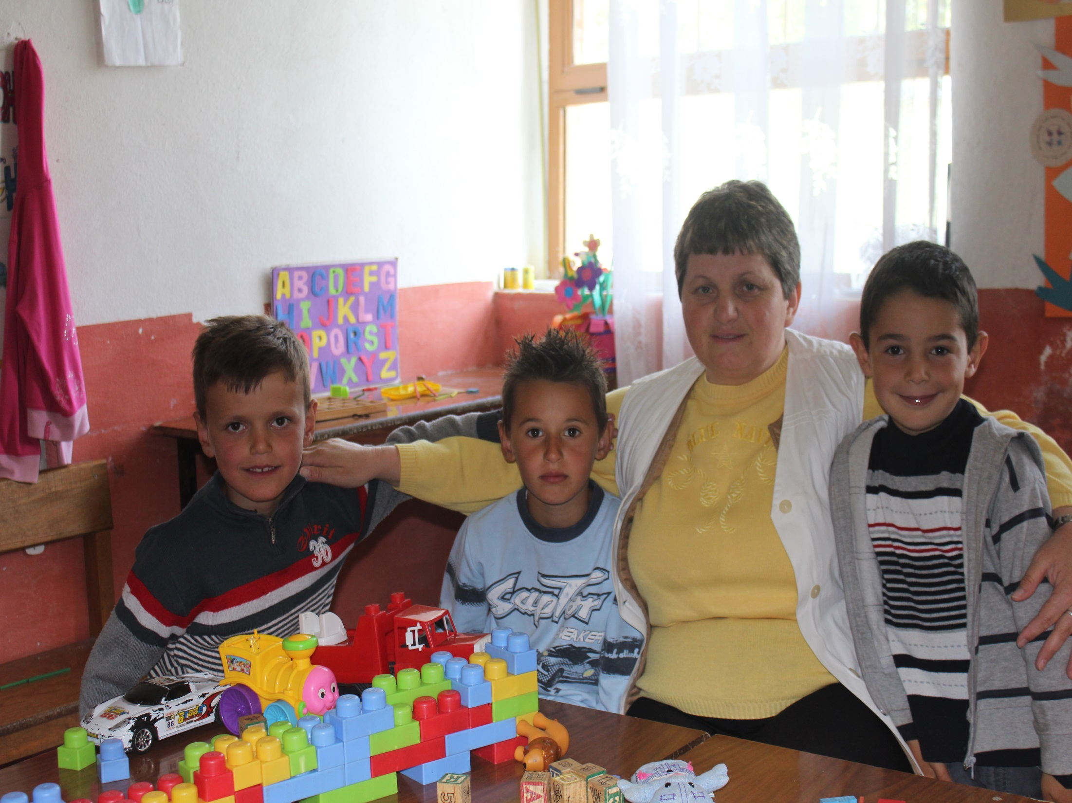
Zagora Kindergarten

Slide 25
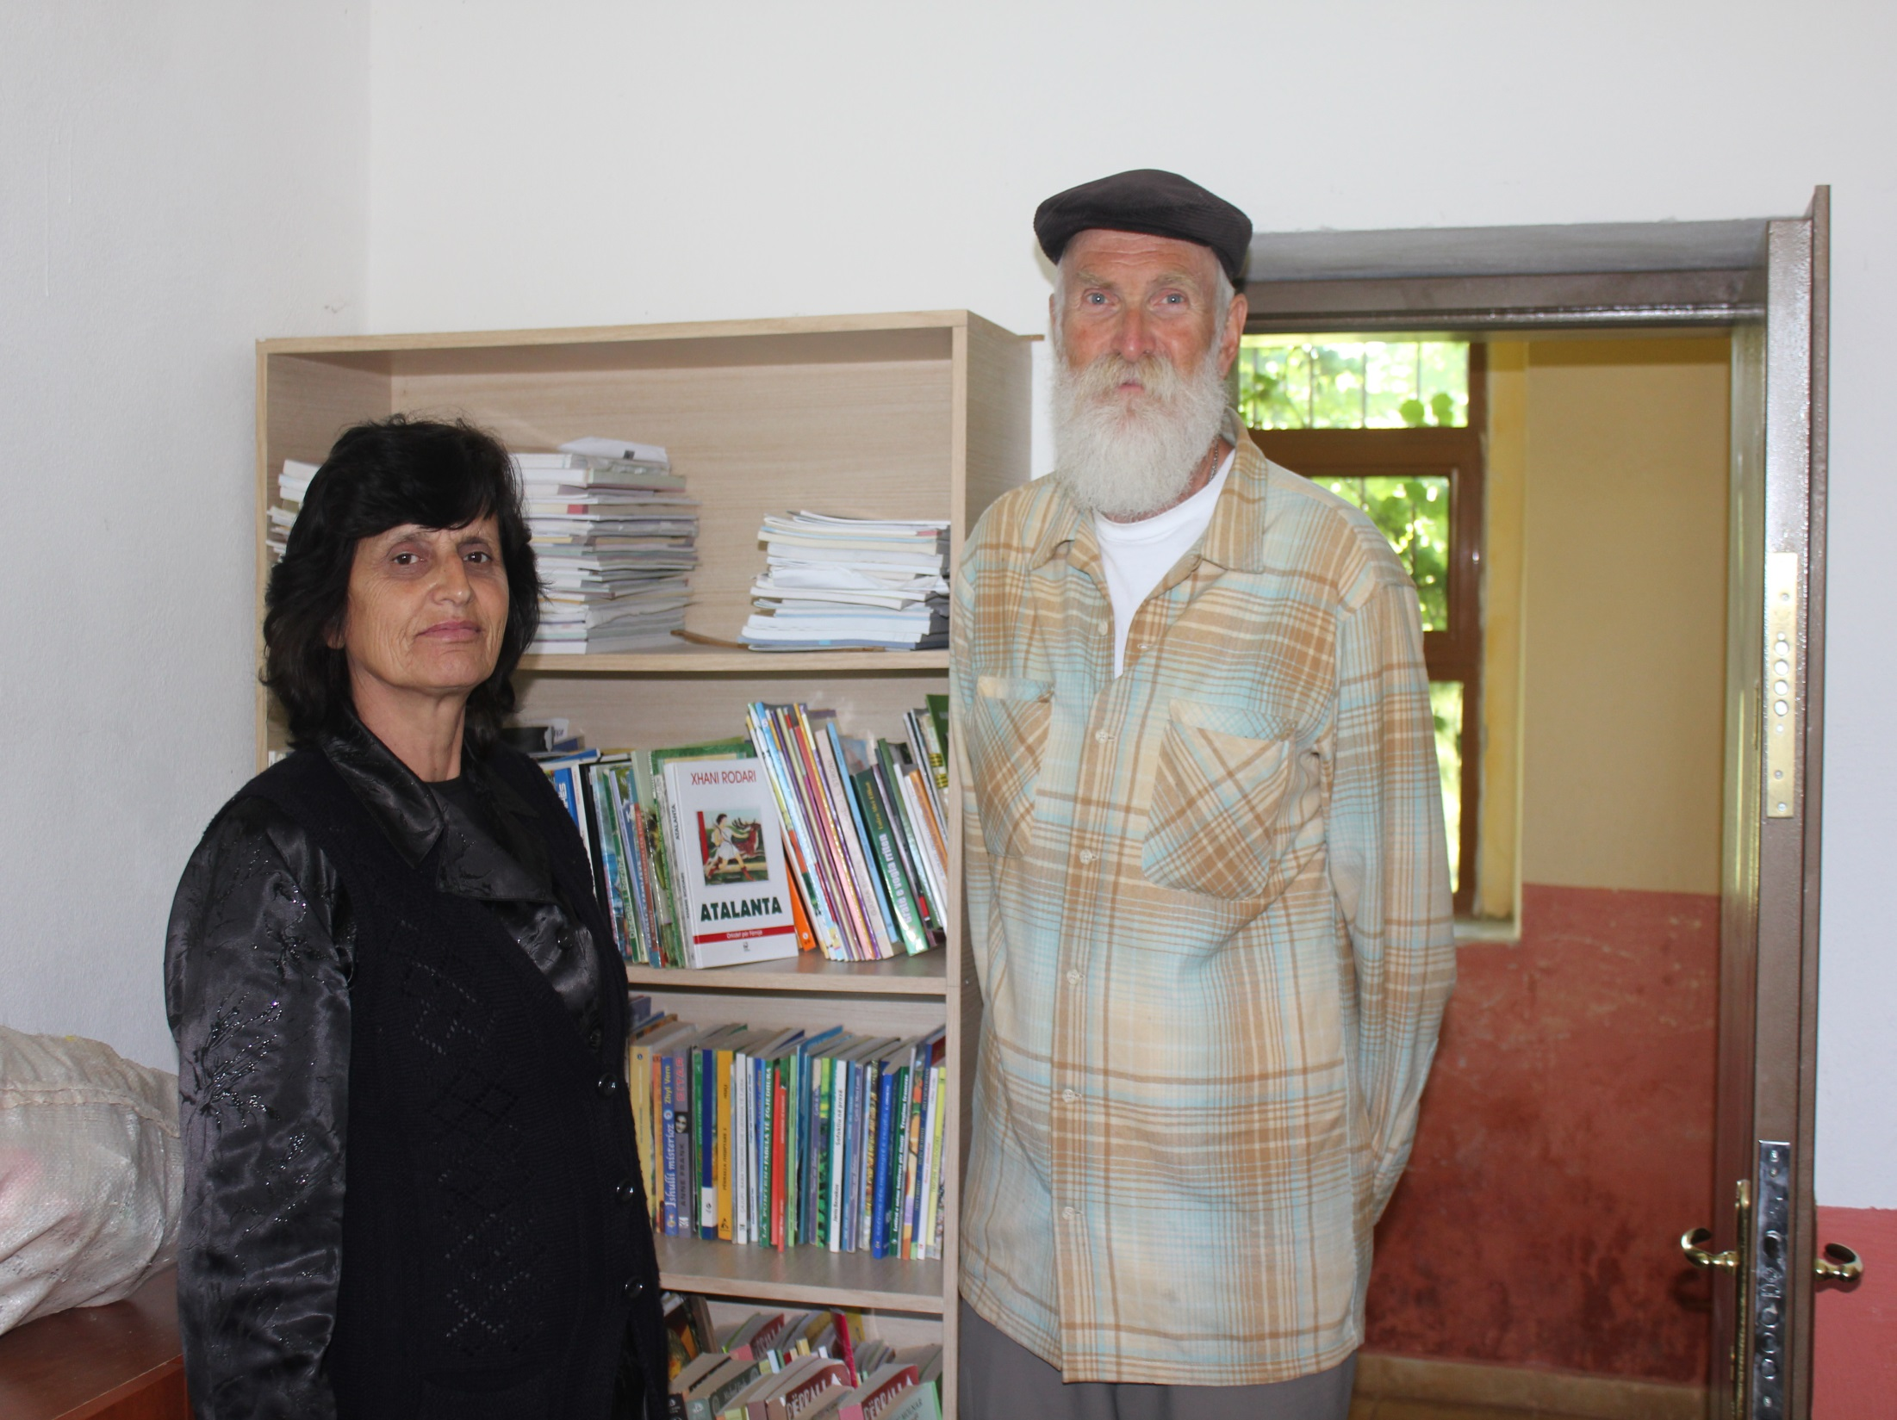
Dielle Qafalia, Zagora School Director and Library

Slide 26
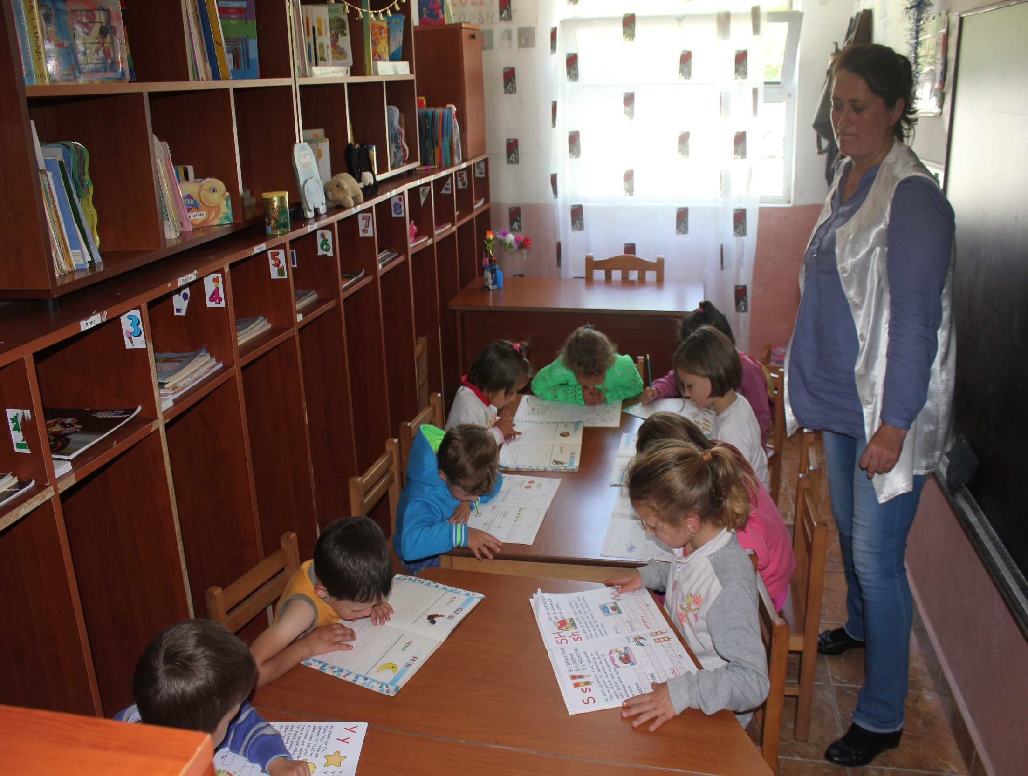
Reci Kindergarten

Slide 27
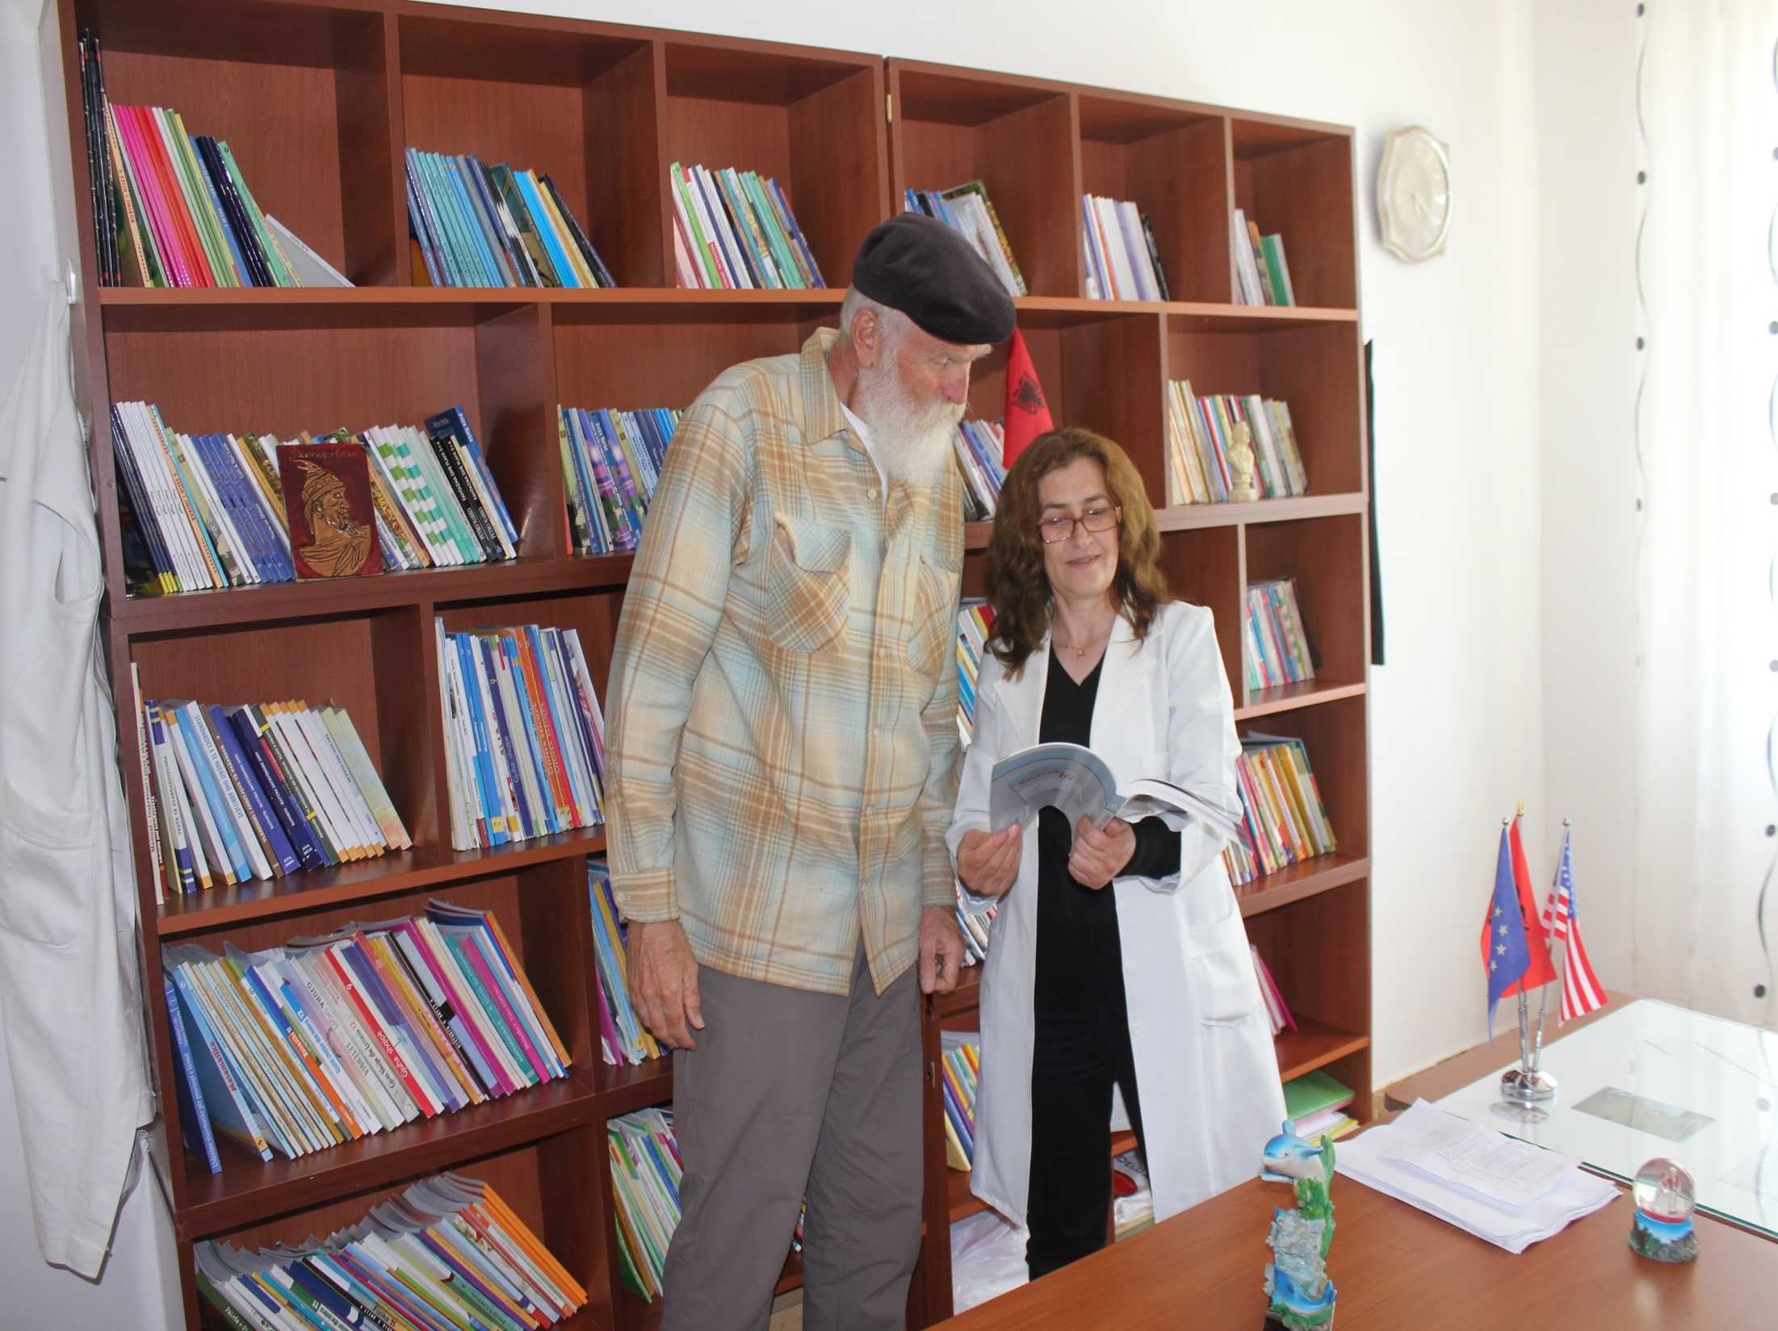
School Director Sabria . . . with Library Books, Reci

Slide 28
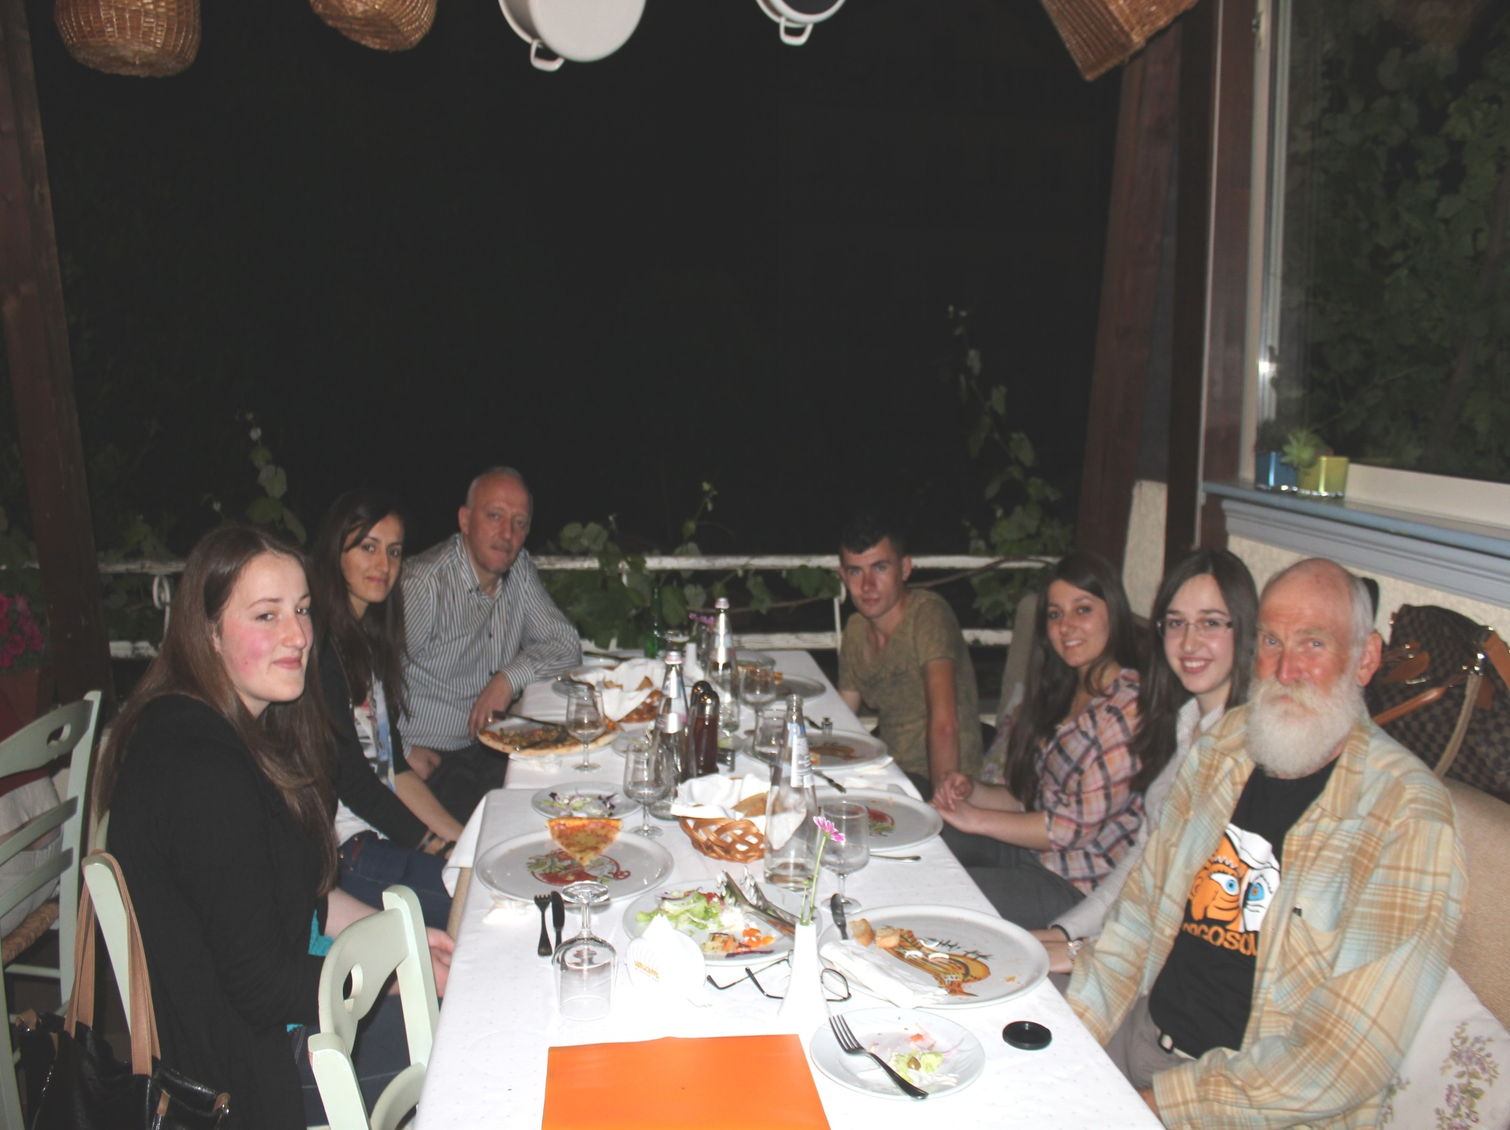
Pizza Dinner for AAI University Scholarship Students:
Marash Rakaj, Brusilda Hoxhaj, Toneta Durgaj,
Aurel Lekaj, Dafina Rakaj, Rregjina Rakaj, Steve

Slide 29
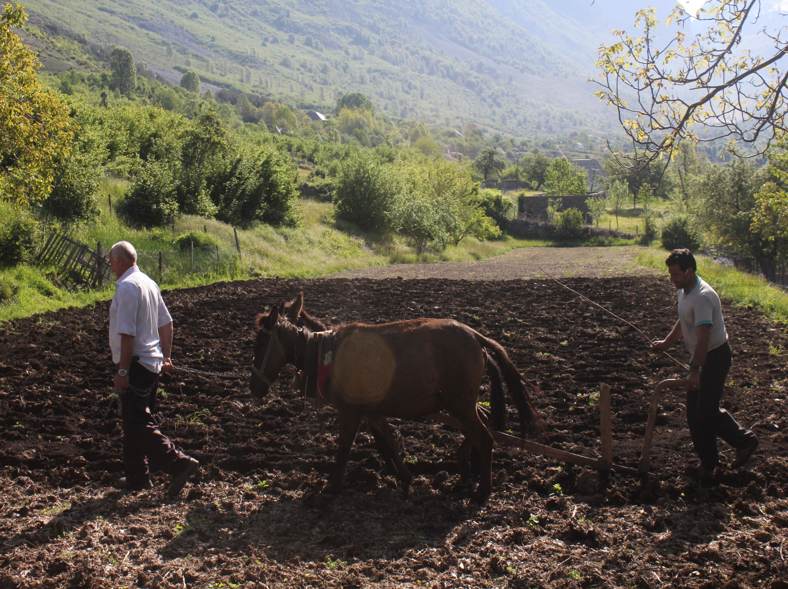
Malesia e Madhe Albania is a mix of the
15th century and the 21st century

